Slide 1
Contagious Effects of Customer Misbehavior in Access-Based Services
Rosellina Ferraro
University of Maryland
(with Tobias Schaefers, Kristina Wittkowski, and Sabine Benoit)
Presented May 11, 2016
Fundacion Ramon Areces
IE Business School

Slide 2
“Really wanted to like [Zipcar] but our first experience was not great. Reservation process on-line was pretty painless but the car was disgusting inside and out. Big coffee/hot chocolate spill on the passenger seat, crumbs everywhere and it stank of smoke. This car was dirrrty and clearly had not been cleaned for several weeks (we are talking old crusty dirt here not new dirt from just one person).” – review of Zipcar on yelp.com

Slide 3
Customer Misbehavior
Defined as behavior that deliberately violates generally accepted codes of conduct in consumption situations (Fullerton and Punj 2004)
  Includes shoplifting, cutting the queue, illegitimate product returns, unwarranted complaining, verbal abuse of employees
Seems to be pervasive (Harris and Reynolds 2003)
Direct vs. indirect forms
  Is problematic for service providers (Harris and Reynolds 2003)
  Negatively affects employees or facilities
  Negatively affects other customers’ experiences
  Implicitly encourages other customers to behave in a similar manner

Slide 4
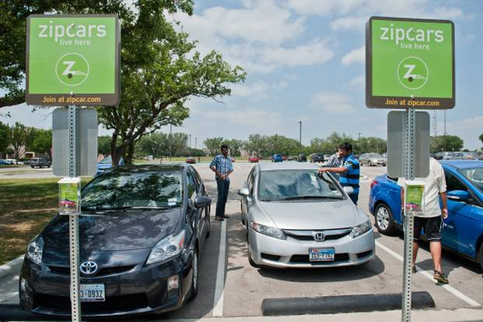
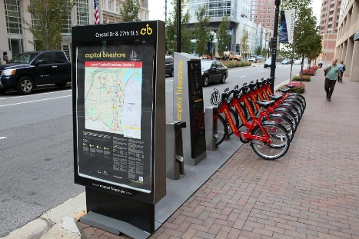
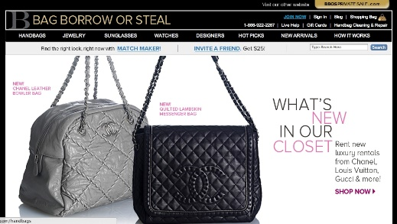
Access-Based Services
Defined as service transactions that allow customers to access a good, physical facility, network, labor, or space for a defined period of time in return for an access payment while legal ownership remains with the owner (Bardhi and Eckhardt 2012; Lovelock and Gummesson 2004)
Customers may be influenced by a desire to share but it is based on an economic exchange of access fees paid by customers

Slide 5
Customer Misbehavior in Access-Based Services
Unique aspects of access-based services
  Failing to act in a responsible manner disrupts use of the product for subsequent customers
  Use often occurs without supervision by service personnel
Consumers prefer to put wear and tear on rented than owned items (Durgee and O’Connor 1995)
Many customers treat Zipcar cars as instrumental and exhibit only a minimal sense of responsibility to other customers (Bardhi and Eckhardt 2012)

Slide 6
Research Question
Is customer misbehavior contagious, particularly in an access-based services context?
If so, what is the process underlying this effect?
If so, what are the moderators of this effect?

Slide 7
Contagiousness of Customer Misbehavior in Access-Based Services
Previous misbehavior positively related to future misbehavior intentions (Daunt and Harris 2010)
A person’s behavior is contagious if it induces others to behave in the same way (Jones and Jones 1992)
  Disorder and criminal behavior (Kelling and Wilson 1982)
  Littering (Cialdini, Reno, and Kallgren 1990; Keizer, Lindenberg, Steg 2008)
  Cheating behavior (Gino, Ayal, Ariely 2009; Paternoster et al. 2013)

Slide 8
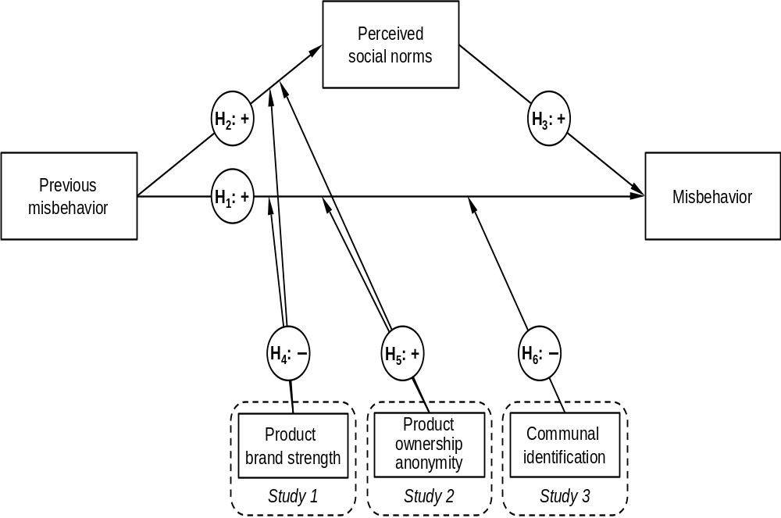

Slide 9
Overview of Studies
Car-sharing context
Study 1 – scenario-based; tests for proposed effect, mediation by social norms, and moderating effect of brand strength
Study 2 – scenario-based; tests for proposed effect, mediation by social norms, and moderating effect of anonymity of ownership
Study 3 – field study with behavioral measure; tests for proposed effect and moderating effect of communal identification

Slide 10
Measures
DV = intentions to misbehave (Studies 1-2)
  I would not clean the car before returning it, even if I made it dirty.
  I would not notify [the service provider/the owner] about a scratch I made in the car.
  I would leave my trash in the car.
  I would not notify [the service provider/the owner] if I slightly damaged the side mirror.
  I would treat the car in a way that others may find unacceptable.
Mediator = perceptions of others’ behavior
  Other customers would not clean the car before returning it, even if they made it dirty.
  Other customers would not notify [the service provider/the owner] about a scratch they made in the car.
  Other customers would leave their trash in the car.
  Other customers would not notify [the service provider/the owner] if they slightly damaged the side mirror.
  Other customers would treat the car in a way that others may find unacceptable.
Alternative explanation – negative reciprocity

Slide 11
Study 1
2 (previous misbehavior: yes, no) X 2 (brand strength: low, high) design
N = 355 participants recruited by a market research service
Stimuli: scenario with photos
Manipulation: dirty and damaged vs. clean and not damaged car; brand logo
Measures
  Covariates: gender, age, tendency for socially desirable responding, proneness for negative reciprocity
  Mediator = Perceptions of others behavior
  DV = Intentions to misbehave
  Manipulation check

Slide 12
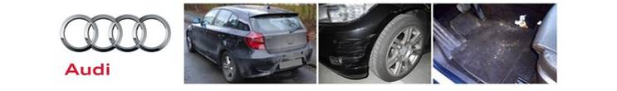
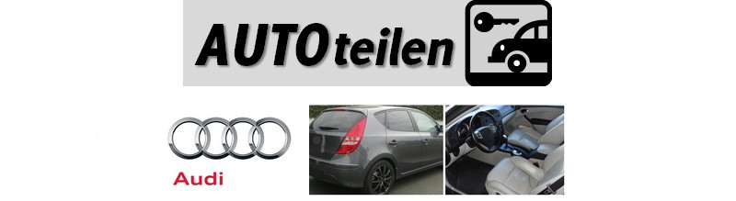
[Introductory text]
You are a registered customer of the car sharing company AUTOshare that offers short-term rental of cars in your city. Now you rent a vehicle from AUTOshare. You pick up the car where the previous user parked it. By holding your AUTOshare card against the card reader in the windshield you unlock the vehicle, which is a [brand] car. At the beginning of your rental the condition of the vehicle is as follows:

Slide 13
Misbehavior: p < .01
Misbehavior X Brand strength: p = .08
Misbehavior: p < .01
Misbehavior X Brand strength: p < .01

Slide 14
Study 2
2 (previous misbehavior: yes, no) X 2 (owner anonymity: anonymous, identified) design
N = 352 participants recruited by a market research service
Covariates: gender, age, tendency for socially desirable responding, proneness for negative reciprocity
Stimuli: scenario with photos
Manipulation: dirty and damaged vs. clean and not damaged car; anonymity via scenario
Measures:
  Mediator = Perceptions of others behavior
  DV = Intentions to misbehave
  Manipulation check

Slide 15
[Introductory text, anonymous owner condition]
You are a registered customer of the car sharing company AUTOshare that offers short-term rental of cars in your city. Now you rent a vehicle from AUTOshare. You pick up the car where the previous user parked it. By holding your AUTOshare card against the card reader in the windshield you unlock the vehicle. At the beginning of your rental the condition of the vehicle is as follows:
[Introductory text, identified owner condition]
You are a registered member of the Internet peer-to-peer car sharing community AUTOshare that lets car owners rent out their vehicles to others. Now you are searching for a vehicle for short-term rental. You find another member close-by with whom you agree on a place and time to meet and pick up the car. At the beginning of your rental the condition of the vehicle is as follows:

Slide 16
Misbehavior: p < .01
Misbehavior X Anonymity: p < .05
Misbehavior: p < .01
Misbehavior X Anonymity: p < .01

Slide 17
Study 3
2 (previous misbehavior: yes, no) level factor X measured communal identification
N = 41 participants recruited at a German university in exchange for extra credit; all were members of a local car-sharing service
One week prior to main task, measured altruism, proneness for negative reciprocity, communal identification with other customers of the car-sharing service
Communal Identification:
  I really identify with other people who use [service provider].
  I really feel like I almost belong to a club with other [service provider] users.
  [Service provider] is used by people like me.
  I feel a deep connection with others who use [service provider].
Task to deliver documents to a set location and given a bottle of water and candy
Manipulation: dirty car vs. clean car; assistants took pictures before and after
DV = condition of car (1 = in better condition to 5 = in worse condition)
Post-drive survey
  Mediator = Perceptions of others’ behavior
  Manipulation check

Slide 18
Misbehavior: p < .05
Communal Identification: p < .05
Misbehavior X Comm Identification: p < .05
Misbehavior: p < .05

Slide 19
Summary of Findings
Evidence for a contagious effect of customer misbehavior
Perceptions that others engage in the behavior mediates the effect of previous misbehavior on subsequent misbehavior
Brand strength and owner anonymity moderate the effect
Communal identification can reverse the misbehavior effect

Slide 20
Contribution and Managerial Implications
Managerial implications
Limitations
Future directions

