Slide 1
Can India Grow Faster?
Lessons from history
Tirthankar Roy
LSE
Talk at
Fundación Ramón Areces
3 November 2015

Slide 2
India changed greatly in the last 20 years
With 17 per cent of the world’s population based in India, 7-8% GDP growth in that region is a big deal for the world.
Why India’s globalization has been impressive
  Heritage and history of connections
  Strong “fundamentals”

Slide 3
What has not changed?
Institutional quality, competitiveness, innovation, quality of life indices place India low
Low productivity – low wage
Poor quality of services

Slide 4
Can India grow faster?
Yes, it can
  An open economy and an open [cosmopolitan] society are different things. India needs more open society, more structured interaction between Indians and others.
What are the obstacle to cosmopolitanism?
Indian politicians do not know how open they want their country to be.
Inside major political parties, there is a fiercely nationalist sentiment
Opening up the services must mean welcoming skilled immigrants – not a priority of policy
    “Why foreign investment still polarizes India,” Washington Post, 2014.

Slide 5
Where does the fear of cosmopolitanism come from?
Reading of colonial history
The sentiment formed during the struggle for freedom from British colonial rule (1858-1947).
British colonial rule pursued open factor markets (capital and labour) as a tenet of policy.
Indian nationalism = Rejection of 19th century liberalism, including cosmopolitanism, on the ground that it impoverished India
“Drain” and “deindustrialization”

Slide 6
What did openness mean in the 19th c., and how was it sustained?
Meaning
Low tariff (→ deindustrialization)
Free movement of capital and labour (→ drain)
Instruments
State control of currency and exchange
State size is small – limited fiscal capacity but high military capacity

Slide 7
Were the nationalists right?
Of course, they were right to fight for liberty. Were they right to claim that openness was damaging?
I believe
They misread facts – Indian poverty was not caused by its openness
Openness, by enabling cosmopolitanism, had benefits for India, but its positive impulse was limited in agriculture – the biggest livelihood.

Slide 8
Chart 1. Pattern of external transactions, 1925 (% of GDP)
How was cosmopolitanism enabled?
Net Invisible
Net Export
Net FDI

Slide 9
Did cosmopolitanism make any difference?
Yes, to trade and manufacturing. No, to agriculture
Chart 2. GDP by main sectors (Rs. m, 1946-7 prices) 1900-1946

Slide 10
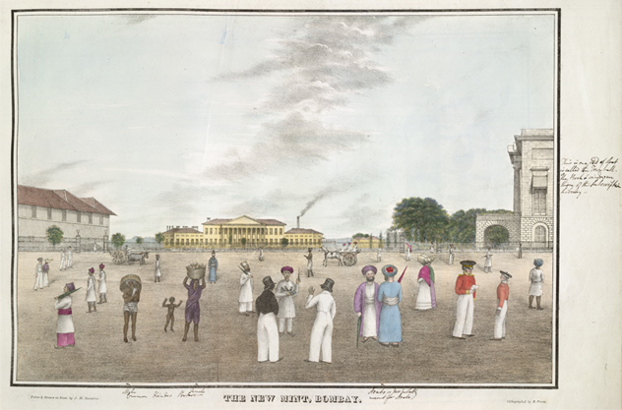
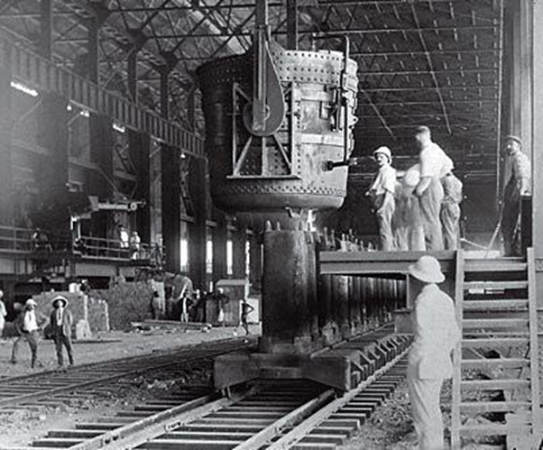
What did openness achieve? – the human contact in trade and industry
Indo-European trade created a cosmopolitan society and outlook in business cities, as in Bombay.
It was easy for an Indian capitalist to hire engineers and buy machines from the world market, which reduced the costs of setting up ambitious projects such as Tata Steel

Slide 11
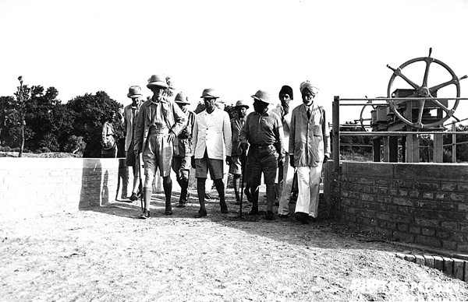
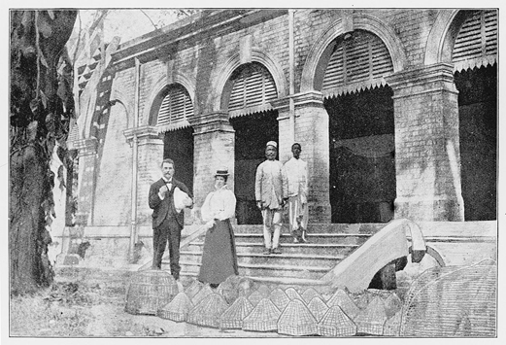
.. and in science and technology
Large public sector construction projects like irrigation canals initiated engineering education
Creating capability in science: officers in government service conducted research on tropical diseases, as did Ronald Ross in Calcutta

Slide 12
Imperial economic system was not politically sustainable
Collapse came with increasing business support for nationalism – after 1929
Resentment against control of monetary system – invisible payment on government account protected by currency manipulation
Neglect of agriculture was a glaring weakness, target of attack by M.K. Gandhi.
The attraction of socialism and state-leadership in industrialization. Capitalist industry tolerated the socialists, in exchange for strong protection.

Slide 13
The new order: (1) trade repression, (2) state expansion
Chart 3. Trade and Government Expenditure in GDP (%)

Slide 14
The new order – (3) factor market closure
Chart 4. External transactions, 1925 and 2010 (% of GDP)

Slide 15
What did the new order achieve?
Capitalist growth, much faster after opening up
Agricultural development, with state aid
Chart 5. GDP by main sectors (Rs. 10 m, 2004-5 prices) 1950-2010

Slide 16
Drawing the right lesson from history
Openness did deliver capitalism and economic growth in both colonial and postcolonial India.
  But differently
    Colonial India: Openness with cosmopolitanism – open borders to movements of skilled workers
    Postcolonial India: Openness without cosmopolitanism – borders are still closed to skills.
Openness does not deliver agricultural growth.
  Government was needed for agricultural growth.
  Government is not necessary for private sector growth.

Slide 17
Can India grow faster?
Yes.
Not by fine-tuning policy
But by embracing cosmopolitanism
By changing the discourse on economic history
Challenges ahead

