Slide 1
Dan Dorner
Senior Energy Analyst, IEA
Madrid, 28 January 2016

Slide 2
Africa Energy Outlook – some context
GDP is rising – rapidly in some cases – but a large share of a fast-growing population still lives in extreme poverty
Sub-Saharan Africa accounts for around 13% of global population, but only 4% of energy use
Energy is vital to development prospects – poor electricity infrastructure is a key impediment to growth
Large energy resource base has been exploited only in part for oil, gas and coal, and largely untouched in the case of renewables
Domestic energy reforms gaining speed, but two-thirds of energy investment since 2000 went to develop resources for export

Slide 3
Rich in resources
Gas
Oil
Gas
Oil
Hydro
Fossil fuels
Wind
Oil
Oil
Solar
Oil
Gas
Coal
Major oil and discoveries in sub-Saharan Africa in recent years;
the region has vast untapped renewables potential, notably hydropower and solar

Slide 4
Rich in resources, but poor in supply
Share of population with
access to electricity:
More than 50%
Less than 50%
In sub-Saharan Africa, 630 million people – two-thirds of the population – live without electricity. Only a handful of countries have electrification rates above 50%

Slide 5
Back-up generators supplement unreliable, insufficient grid-based supply
Electricity demand met by back-up generators in sub-Saharan Africa
by sub-region, 2012
Industry
Nigeria
Services
Other West
Residential
Central
East
Southern
2
4
6
8
10
12
TWh
Back-up generators consume around 90 thousand barrels of oil per day
to generate electricity, at an estimated cost of over $5 billion

Slide 6
Energy demand by sub-region
Sub-Saharan Africa primary energy mix by sub-region, 2012
141 Mtoe
56
Mtoe
37 Mtoe
112 Mtoe
83 Mtoe
141 Mtoe
100%
Other renewables
Bioenergy
80%
Hydro
60%
Nuclear
Gas
40%
Oil
Coal
20%
Nigeria
Other
Central
East
Other
South
West
Southern
Africa
Nigeria and South Africa are sub-Saharan Africa’s largest energy demand centres, accounting collectively for half of total demand

Slide 7
Biomass remains at the centre of the sub-Saharan energy mix
Total primary energy demand in sub-Saharan Africa
Biomass
Oil
Coal
2012
Additional
demand in 2040
Modern renewables
Gas
Nuclear
100
200
300
400
500
Mtoe
Mtoe
Reliance on fuelwood and charcoal remains high, even as incomes grow;
650 million people still cook with biomass in an inefficient, hazardous way in 2040

Slide 8
Power to shape the future
Installed power generation capacity by fuel in sub-Saharan Africa
2040 capacity: 380 GW
2012 capacity: 90 GW
Bioenergy, wind
geothermal
Other renewables
8%
Coal
0%
Solar
22%
12%
Hydro
Nuclear, 2%
22%
Coal
45%
Oil, 17%
Hydro
24%
Gas
Gas, 14%
25%
Oil
7%
Nuclear
2%
Renewables account for almost half the growth in overall power supply,
but fossil fuels are prominent in some countries

Slide 9
Different paths to power across the continent
600
West
300
East
TWh
TWh
250
500
400
200
300
150
200
100
100
50
2000
2020
2040
2000
2020
2040
150
Central
1 000
Southern
TWh
TWh
120
800
90
600
60
Other
renewables
Nuclear
400
30
Gas
200
Solar PV
Oil
Hydro
Coal
2000
2020
2040
2000
2020
2040
The power mix by sub-region reflects local resource endowments; well-functioning regional power pools help to unlock new projects, lower costs & improve reliability

Slide 10
Important role for renewables beyond the grid
Technology mix for mini-grids and off grids in sub-Saharan Africa, 2040
Mini
-
grid: 26 TWh
Off
-
grid: 12 TWh
3%
2%
8%
4%
12%
32%
Oil
35%
20%
Solar PV
Hydro
Wind
Bioenergy
47%
37%
Renewables – led by solar and hydro – account for two-thirds of the
electricity supplied by mini-grid and off-grid systems

Slide 11
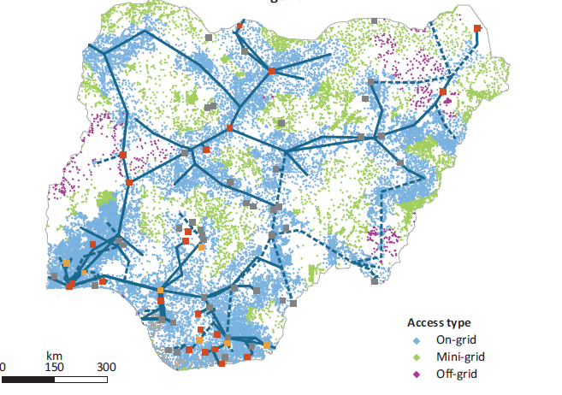

The most cost-effective way to expand electrification varies
Optimal split by grid type in Nigeria, given expected expansion of transmission lines
Source: IEA in collaboration with the KTH Royal Institute of Technology, division of Energy Systems Analysis.
In Nigeria, higher population density and wider grid coverage favour on-grid supply; where grid extensions are not cost-effective, mini-grids tend to be preferred

Slide 12
The most cost-effective way to expand electrification varies
Optimal split by grid type in Ethiopia, given expected expansion of transmission lines
Source: IEA in collaboration with the KTH Royal Institute of Technology, division of Energy Systems Analysis.
The overall population density of Ethiopia is half that of Nigeria meaning that mini- and, especially, off-grid solutions play a much more prominent role

Slide 13
A changing balance to oil production
Oil production in sub-Saharan Africa
mb/d
7
Production:
6
Other
5
Angola
Nigeria
4
3
2
1
2000
2014
2020
2030
2040
The region remains a major global supplier, although the role of the
two biggest producers (Nigeria and Angola) ebbs and flows

Slide 14
A new global gas player
Increase in gas production in selected countries & regions, 2013-2040
United States
Angola
Sub-Saharan Africa
Mozambique
Nigeria
Other
Tanzania
Russia
Australia
North Africa
50
100
150
200
250
bcm
LNG export is the anchor for the east coast gas discoveries, but a major share of the increase in overall gas output goes to domestic power generation and industry

Slide 15
Investment has to come home
Average annual investment in sub-Saharan energy supply
120
100
Billion dollars (2013)
For export
80
⅔
For consumption within
sub-Saharan Africa:
60
⅓
Fuels
40
Electricity
20
⅔
⅓
2000-2013
2014-2040
In a reversal of current trends, 2 out of 3 future investment dollars produce energy for sub-Saharan consumers, but this is still not enough to meet their needs in full

Slide 16
A large step towards universal access, but still a long way to go
Access to electricity in sub-Saharan Africa
Million
1 800
1 500
Population with
electricity access
1 200
Population without
electricity access
900
600
300
2012
2020
2025
2030
2035
2040
Nearly one billion people gain access to electricity, but over 500 million remain without power in 2040 – primarily in rural communities

Slide 17
Biomass continues to dominate energy demand for cooking
Primary fuel/technology used by household for cooking in sub-Saharan Africa
in the New Policies Scenario
Urban
Rural
2012
Electricity
Southern
2040
LPG, Gas
2012
Kerosene
East
2040
Traditional
stoves
2012
Improved
cookstoves
Central
2040
2012
Other
renewables
West
2040
20%
40%
60%
80%
100%
20%
40%
60%
80%
100%
In urban areas, access to clean cooking facilities is mainly by fuel switching,
while in rural areas it is mainly via improved biomass cookstoves

Slide 18
How could energy make the 21st century an African century?
Energy could do more to act as an engine of inclusive economic and social development
An African Century Case assesses the impact of faster movement in three key areas:
  An upgraded power sector; reducing power outages by half and achieving universal access in urban areas
  Deeper regional co-operation; expanding markets and unlocking a greater share of the continent’s hydropower potential
  Better management of resources and revenues; more efficiency and transparency in financing essential infrastructure

Slide 19
Energy can build a path to prosperity
Outcomes in the African Century Case, 2040
5
280
700
240
Gigawatts
600
4
Million people
Main Scenario
200
500
3
160
400
African Century
Case
Thousand dollars (2013, MER)
2
120
300
80
200
1
40
100
GDP per capita
Renewables-based
power generation capacity
Without access
to electricity
By increasing the coverage and reliability of energy supply, the African Century Case unlocks an extra decade’s worth of growth in per-capita incomes by 2040

Slide 20
Conclusions
Energy is a cornerstone of sub-Saharan strategies for poverty reduction and economic growth
Improvements in sector governance are needed to bring in new energy investors and kick-start development
The shortest route to power is a combination of regional and national level grid projects, and mini-off grid projects
Renewables are central to the regions energy outlook, while more efficient and sustainable use of biomass will create a healthier domestic energy balance
Concerted action to improve the functioning of the energy sector is essential if the 21st century is to become an African century

Slide 21
Available to download for free at www.worldenergyoutlook.org

