Slide 1

It’s Not 9.8 Meters per Second Squared, Anymore
Ed Leamer
June 2016

Slide 2
3% per Year
Was the Economic Equivalent of
9.8 meters per second squared

Slide 3
The US Labor Market is also Troubled

Slide 4
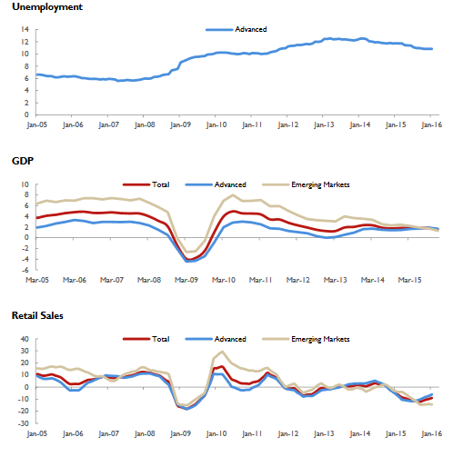

The global economy is struggling
In the advanced economies unemployment is persistently high
Both advanced and emerging economies GDP growth have converged to the same low level.
And growth of retail sales is, alarmingly, negative.

Slide 5

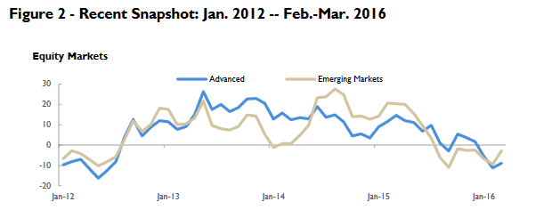
And Equity Markets Are Frowning

Slide 6
Growth is critical
Government revenues
Retirement liabilities
Equity Prices
Unemployed and/or discouraged workers
Our democracy

Slide 7
We Have Been There Before
Notice how little wiggling has been going on after 2010!

Slide 8

My take on: “What’s the Matter?”
Transition from Industrial to Post-industrial Economies, amplified by the microprocessor
  Manufacturing was the solution, now it’s the problem.
  Training was the solution; now it takes education
Aging of the advanced developed countries
  Lower growth of working-age populations
  Large increases in the ratio of non-workers to workers (the dependency ratio)
  Caring for the elderly is an “off-shore” (Enron-style) liability of most governments, which are already too indebted.

Slide 9






Structural Changes
20th Century: Moving Workers off the Farms onto the factory floors
21st Century: Moving workers off the factory floors into intellectual services. (a selected few)

Slide 10

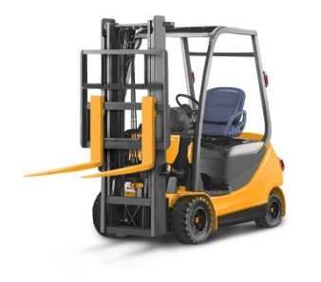



Technological Change
A Force That Drives the Economy
20th Century: Equipment That Makes Us All More Productive At Physical Tasks
21st Century: Equipment Makes the Naturally Talented More Productive at Intellectual Tasks
21st Century: Equipment Does the Mundane, Repetitive, Codifiable Manual and Intellectual Tasks
From Manufacturing to Neurofacturing

Slide 11





Demographic Transitions
A Force That Drives the Economy
1960s: High School Grads Rushing Off to Work in the factories
2016: Retirees toddling warily into whatever lies ahead.

Slide 12


The first hint of the politics to come

Slide 13


Maybe Part of The Problem is that
Bad Debt Lingers On
Losses on equities are quickly transferred to private balance sheets.
Losses on leveraged homes take a long time to locate the losers: home owner, banks or taxpayers.
How long are we going to cling to this view??

Slide 14
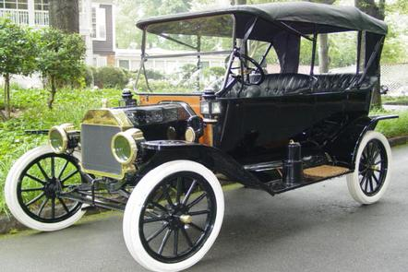


Is It Just a Measurement Problem?
Manufacturing
Intellectual Services
Free Information

Slide 15
Demographics Surely Matter
In the 1960s, the largest population groups were the kids (1-15) and the young adults(16-24). Now it’s 65+.

Slide 16
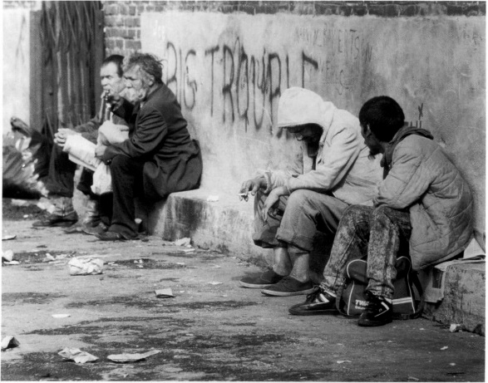
The 65+ is Really Going to Grow

Slide 17
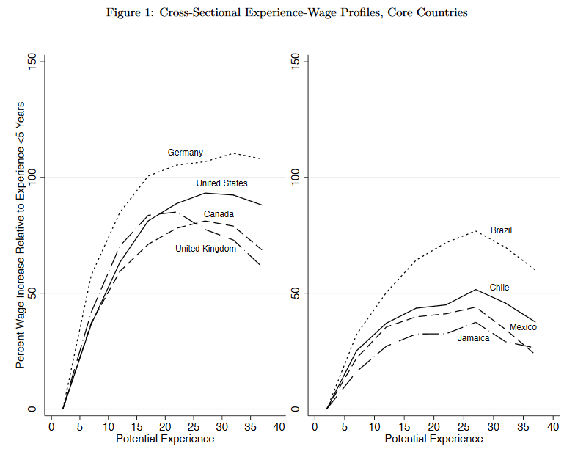
One Reason This Matters is that Wages Rise Sharply During the first 20 years of Work Experience

Slide 18
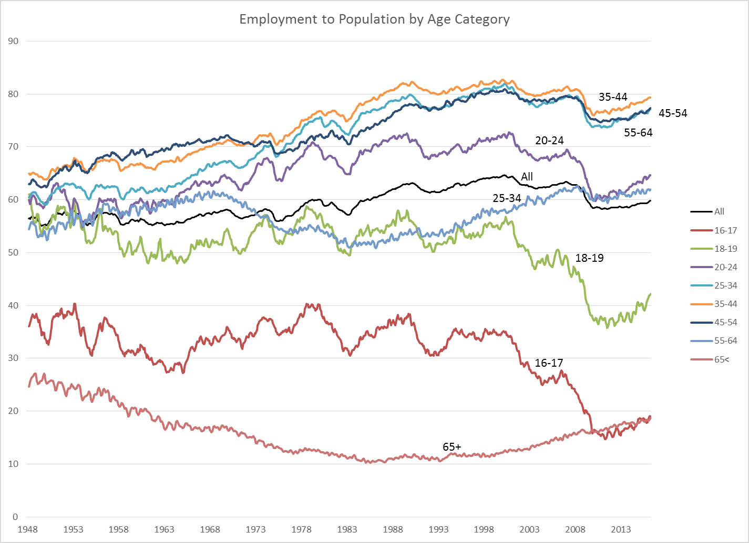
Another Reason Why Demographics Matter is that the Employment to Population Ratio is low for the Young and the Elderly

Slide 19



Normal Recession
Temporary Layoffs Followed by Recalls
Work
Temporary Layoff
Recall

Slide 20



Secular Adjustment
Adios, Buddy
Work
Long Unemployment Spell
Reluctant acceptance

Slide 21

Looking for secular changes
Negative trend in manufacturing.
Excess capacity in residential construction.
Computerization of routine, repetitive intellectual tasks.

Slide 22
What’s Different?
Permanent Displacements in Manufacturing!

Slide 23
Negative Trend Turns V into L
Cost-Cutting + Trend = Cycle
+
=
+
=

Slide 24



ALERT: Aliens are taking the jobs of Americans!
They work long hours without complaint.
They are happy with low pay.
They don’t care about working conditions.
They aren’t interested in joining unions.
They don’t fall in love.
Walls won’t keep them out.
They’re beautiful.
Who are they?

Slide 25


Complements or Substitutes?
The forklift eliminates god-given strength as a determinant of productivity.
The microphone makes god-given talent a critical requirement.
  Effort and education are not substitutes for talent.

Slide 26
Mundane Tasks are the Computer’s Job
In this fast-changing world, the decision-making of a year ago is either programmed or out of date.
There is a difference between artificial intelligence and real intelligence.

Slide 28
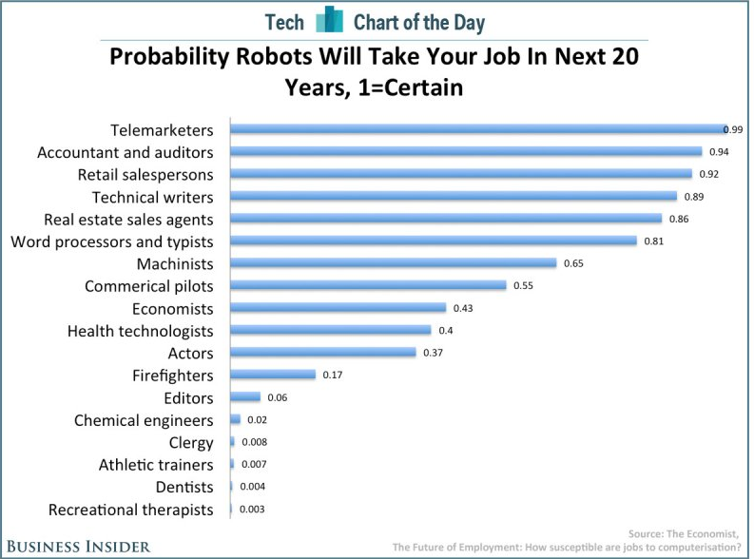

Slide 29
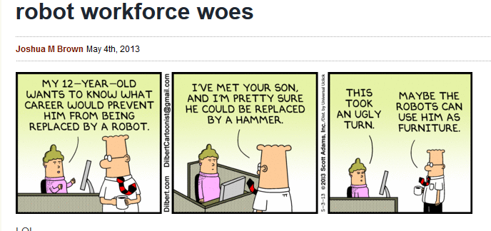
Dilbert

Slide 30

The Long-Term Forecast Remains Troubled

Slide 31
Slower Growth Ahead

Slide 32



What Bernie Sanders Isn’t Talking About
Debt and Aging and Health Care
Ready or Not, Here We Come

Slide 33
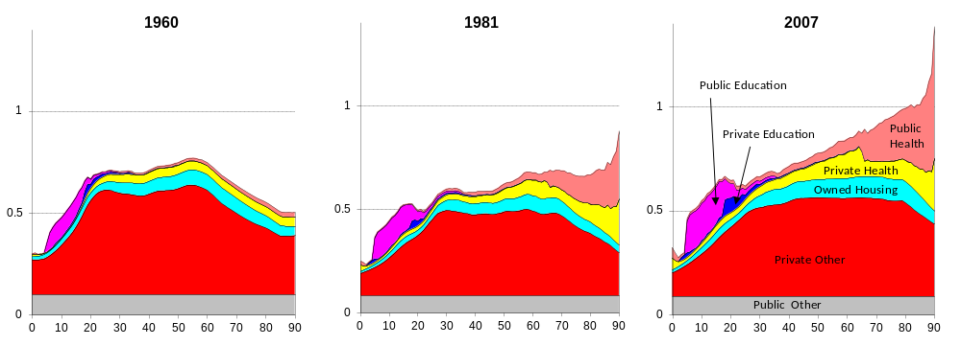
US consumption Per Capita by Age
1960, 1981 and 2007
(Ratio to average labor income ages 30-49)
Source: US National Transfer Accounts, Lee and Donehower, 2011

Slide 34
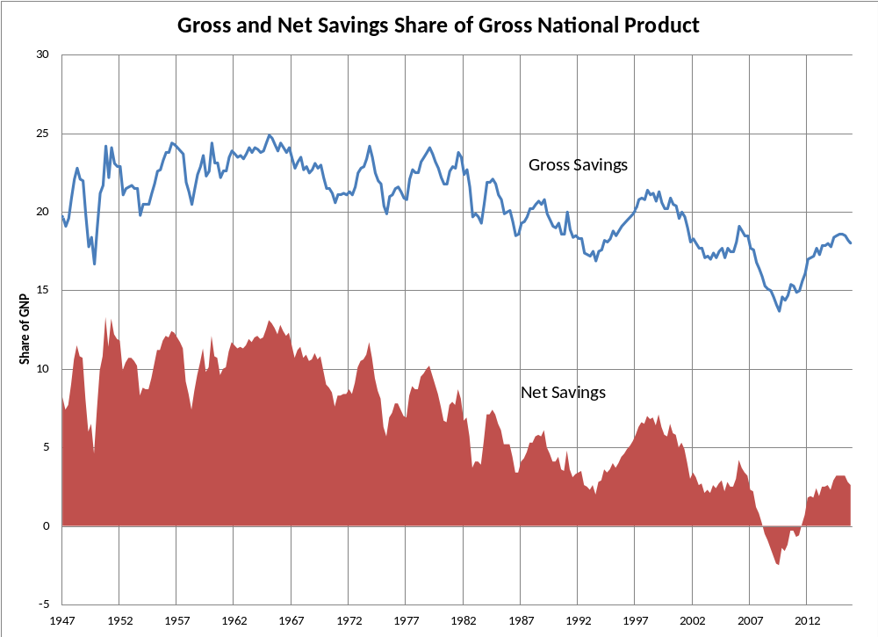
We Aren’t Saving Much Any More

Slide 35
Who is Saving, and Who Isn’t?

Slide 36
Messages
We need much higher national savings rates to prepare for our retirees because of
  Lower income growth rates
  Lower rates of return on investment
  More spending opportunities late in life. (health care)

Slide 37
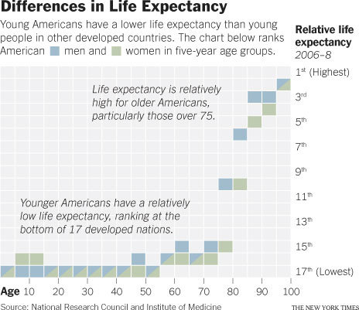
Who is well treated and who is not?

Slide 38
In summary, we desperately need:
Major workforce development
Much greater savings
More public spending on the young and less on the old.
  Infrastructure

Slide 39
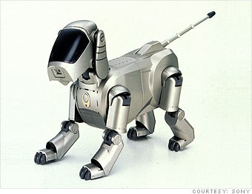
Bye for Now
I am going to walk my new dog.

