Slide 1
REFLECTIONS ABOUT A POLICY FOR INDUSTRY 4.0 IN SPAIN
José Molero
Instituto Complutense de Estudios Internacionales
Universidad Complutense de Madrid

Slide 2
Contextual elements for the presentation
We shall not address digitalisation as a whole, but industry
It is not a technological analysis but a reflection from the Political Economy perspective
My basic question is: How to take advantage of this window of opportunity in an intermediate country?
Suddenly the issue of the System arises, mainly interactions between actors and institutions
I wonder whether there is an amount of uncritical optimism
An old learning: a key factor is the combination of new technologies and institutions with already existing ones

Slide 3
Circular causation perspective
Basic-structural conditions
Technological capabilities
Complementary Assets
Institutions and Policies
Foreign
International
Context

Slide 4
Basic-Structural conditions
Industrial decrease
Little weight of technology intensive sectors
Small size of firms
Critical presence of foreign capital in determinant sectors
Heritage of oligopolies linked to State policies
Less use of ICTs technologies

Slide 6
Technological capabilities: Agents and resources
Innovative enterprises in Industry
Investment in technology by innovatory firms
International comparison
Technological advantages and disadvantages
How to evaluate emerging technologies and give priorities
The technological cycle and differences for policies

Slide 8
 | Innovatory firms. Total | % of innovatory firms | Innovation intensity (% sales)
Overall industry | 7,061 | 23.18 | 1.14
Spanish Innovation Survey 2015

Slide 9
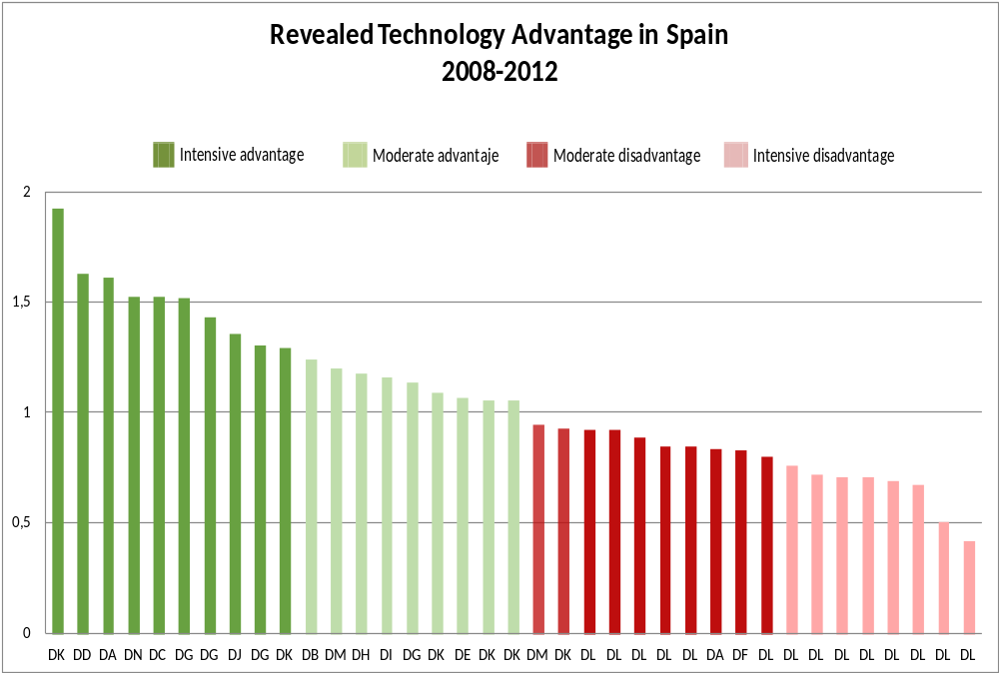
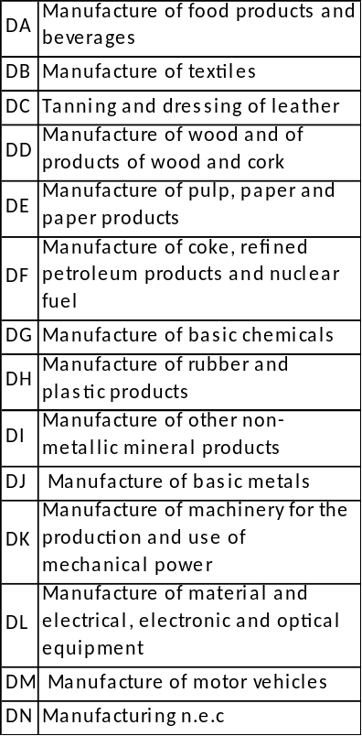

Slide 10
Foreign international context (I)
The creation of domestic capabilities is not independent from the capacity to incorporate, learn and integrate knowledge coming form overseas in different ways
Spain growingly integrated in international flows of knowledge. In the last two decades particular attention to be pay for: foreign trade (exports) and outwards FDI.
However some critical aspects have to be taking into account. To follow this is useful the “old” distinction between embodied (trade, FDI spontaneous cooperation) and disembodied technology (licenses, patents, technological agreements, formal cooperation)

Slide 11
Foreign international context (embodied ways I)
Foreign trade:
The most challenging data is the deficit in high technology products. According to the last figures (2014), while the Spanish exports cover 90% of the imports, in HT product, the coverture is much lesser: 57%.
Particularly important are those related with ICTs. Office machinery and computers (19.6%); Electronic equipment (26.5%); Scientific instruments (41.7%) and Electric Machinery and Materials (37.8%)

Slide 12
Foreign international context (embodied ways II)
FDI:
In the last decades Spain has reached a new position with outward FDI overcoming inward one.
The most challenging aspects are the followings:
  In 2014 MNEs R&D activity in Spain was 37.04 % of total business R&D (in practical terms is higher). But this is in a very asymmetric position because while for Spanish economy this is a great amount (in a country with low business R&D), just in few occasions that activity is crucial for the global MN group.
  As has been found in recent studies, that foreign presence is also important in HT sectors. However, this has not been enough to upgrade the Spanish international position in those sectors (Molero & García, 2008; García, Molero and Rama, 2016)

Slide 13
Foreign international context (Disembodied ways)
Spanish deficit in Royalties. In 2015
  Receipts.1,457 M€; Payments 4,077 M€ (35,7 % coverage).
  Moreover, one of the countries in which the growth of receipts is slowest
The weight of domestic patents versus foreign ones is one of the lowest in OECD area
International collaboration: bigger in scientific co-publications smaller in co-patenting

Slide 14
Complementary assets
Education and training:
  Little attention to secondary education
  Necessary radical change in University, including social sciences (Management, impacts, assessment…)
  Deficits in Vocational Training
  Deficits in Long Life Training
Excessive dependence on public resources: the necessity of more and better financial mechanisms
Labour market:
  Lower active population
  Old fashion concept of flexibility. Permanent learning for a new flexibility framework
Regulation: Sustainability and credibility

Slide 15
Institutions and policies
Advances and stagnation in innovation policies: the necessity of a new State strategy
The particular case of Public Budgets: 2016, 66% with respect to 2009
Inter ministries coordination
Inter territorial coordination (regional governments)
Little impact assessment of policies
Uneven internationalisation: excessive concentration in Europe

Slide 16
The necessity of a “big push”
The necessity of moving the Wheel from all axes; not just from one (eg, size of firms; R&D&I investment, financial resources, education and training and so on)
We need a new way of making policies, more articulated and coordinated
But above all, credible: We need the topic to be in the center of the political agenda. Simple declarations or Power Point presentations are not enough
If we work hard, it is not impossible to recuperate the lost time; nevertheless it is not easy either instantaneous
Examples: size, HT sectors promotion, ICTs use, Innovation investment and policies, Labour market, education

Slide 17
THANK YOU!
José Molero jmolero@icei.ucm.es

