Slide 1
The strengths and limitations of PISA for policymaking
Dr. John Jerrim
UCL Institute of Education

Slide 2
What do policymakers really want to know?
What are our country’s educational strengths?
What are our country’s educational weaknesses?
What demographic groups / schools / regions should we target policy at?
At what age should we be intervening?
What exactly should we change about our education system? And how?
What policies should we introduce?

Slide 3
PISA is helpful in helping us understand some of these issues……
….but very little use for others

Slide 4
Example: Socio-economic inequalities in Spain
PISA 2009 (reading)
80 PISA points difference between rich and poor
Equal to around two years of schooling
Sounds bad!!

Slide 5
Example: Socio-economic inequalities in Spain
Things look different in a comparative perspective……..
Actually not doing too badly with respect to other countries…..
How much is this really a weakness for Spain!?

Slide 6
PISA is like a mirror…..
It gives us an objective reflection on the situation in a country relative to others….
It helps us understand our own comparative strengths and weaknesses…..
….as well as those of other countries
Gives us (and policymakers) the chance to take a good, long hard look at ourselves

Slide 7
So PISA helps us understand what our problems REALLY are……
….but a lot less about what to do about them!!
Limitations of PISA

Slide 8
Low Spanish performance in PISA. What should we do?
Lots of educational reform……..
……mainly in lower secondary school.
But is this really the point where education reforms should be targeted? Rather than pre-school, primary school etc?
PISA alone does not allow us to answer this question!
Our example for Spain (Choi and Jerrim 2015)

Slide 9
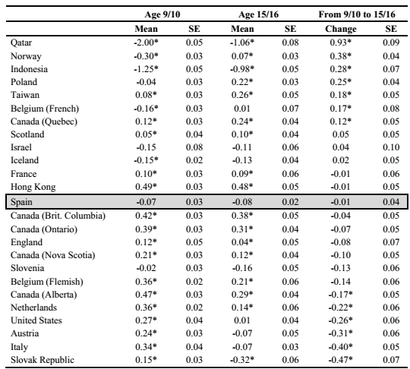
Our example for Spain (Choi and Jerrim 2015)
Compare comparative performance in PIRLS 2006 and PISA 2012……
Spanish kids make just as much progress in secondary schools as those in Hong Kong!!!
In comparative terms, Spanish children seem to do OK during secondary school……
Problems may start much earlier……
….then hard to recover from a bad start?
PISA = cross-sectional data.
Limited use in knowing whats going wrong and at what age.
Hard to decipher where policymakers should therefore invest!!

Slide 10
Another example
Are Shanghai secondary schools really that great?

Slide 11
Issue: ‘Value added’ measures don’t exist in PISA
But, for some countries, we can get a proxy, for some economies.......
…..including Shanghai
Relies on fact PISA samples children from multiple school grades
‘Fuzzy’ Regression Discontinuity Design (RDD)…
Gives an estimate of how much progress children make over one school year…..

Slide 12
RDD intuition
Impact of one additional year of schooling upon children’s PISA test scores = 40 points

Slide 13
RDD results for Shanghai
Actually very little going on around the discontinuity in Shanghai……
Notes:
My calculations PISA 2012 only (no 2009 data included)

Slide 14
RDD results for Chinese Taipei
Actually very little going on around the discontinuity in Shanghai……
Notes:
My calculations PISA 2012 only (no 2009 data included)

Slide 15
Summary of results
 | PISA points progress made over one academic year
 | Shanghai | Chinese Taipei
Reading | 2.9 | 0.8
Mathematics | 1.2 | 0.9
Science | -3.1 | -2.0
Key Implication
Children in Shanghai and Chinese Taipei actually make very little progress in secondary school………
….at least between grade 9 and grade 10
Notes:
Based on Andy Mac analysis. PISA 2009 and 2012 combined.

Slide 16
How then should we move from PISA to policy?
The example of England

Slide 17
Moving from PISA to policy
Step 1. Use PISA / PIRLS / TIMSS to identify an area of weakness…….
Step 2. Use qualitative research to identify best practise in other countries…..
Step 3. Adapt this practise so it can be implemented within your national context…..
Step 4. Pilot in a selection of schools, with a robust impact evaluation (e.g. an RCT)….
Step 5. If successful, start to role out at scale (continuing to evaluate as you go)…….
PISA is the first step in a long process!

Slide 18
Example from England. Maths Mastery.
‘Maths Mastery’ (MM) programme introduced into a selection of English primary and secondary schools.
Change to how maths is taught in England’s schools.
Based upon methods used in Singapore (2nd in PISA rankings).
Evaluate impact. Two clustered RCTs.
Cost-effectiveness and cost-benefit calculated.

Slide 19
Results….
 | Primary school | Secondary school | Meta (combined)
Number of schools | 90 | 50 | 140
School response rate | 92 percent | 88 percent | -
Number of pupils | 5,108 | 7,712 | 12,820
Pupil response rate | 82 percent | 77 percent | -
Effect size | 0.099* | 0.055 | 0.077**
Standard error | 0.054 | 0.046 | 0.036
95% confidence interval | -0.009 to 0.207 | -0.037 to 0.147 | 0.007 to 0.147

Slide 20

Another example: Shanghai exchange
Ministers
‘This represents a real opportunity for us to see at first hand the teaching methods that have enabled their young people to achieve so well in maths’

Slide 21
Conclusions
PISA is data. Nothing more. Nothing less.
Like any data……
…..has strengths and limitations
…..can inform policy (when used properly)
…..but can’t tell us all we need to know
PISA = Starting point to think about educational policy change……
…. Need information from other international studies (e.g. PIRLS, TIMSS)
…. Need information from national data
…. Need interventions and impact evaluation

Slide 23
Six things you need to know about East Asian PISA success…..
Dr. John Jerrim
UCL Institute of Education

Slide 24
Context: PISA 2012 (mathematics)
East Asian economies between two and three years of schooling ahead of the West…..
Note:
Dashed lines represent number of years of schooling behind Shanghai

Slide 25
Context: PISA 2012 (mathematics)
Note:
Dashed lines represent number of years of schooling behind Shanghai

Slide 26
Media reaction
OECD (Andreas S.): ‘What Asian schools can teach the rest of the world’
BBC: Pisa tests: UK stagnates as Shanghai tops league table
The Economist: Diligent Asia, indolent West
TIME: China is Cheating the World Student Rankings System

Slide 27
Policy reaction in England
Ministers
‘This represents a real opportunity for us to see at first hand the teaching methods that have enabled their young people to achieve so well in maths’

Slide 28
Private tuition?
Maths curriculum?
Teaching methods?
Why?
Cheating?
Intelligence?
Value education highly?
Teacher quality?
“Tiger mums”?

Slide 29
The real answer? We don’t know!
Answering ‘why’ = Very hard!
But we can scrutinise data to try and get closer to the answer…
Today = I am going to give you what I think are the key points based upon my work and wider literature….
Evidence based!!!

Slide 30
The topics I will cover…..
Is this really news?
Would China’s results differ if regions other than Shanghai be included?
Is this about East Asian schooling systems? Or East Asian culture?
Shanghai as the ‘world’s best schooling system’. But how much progress do pupils really make?
Is it because East Asian children are simply ‘more intelligent’?
Do East Asian children really suffer negative consequences?

Slide 31
1. Is East Asian dominance of such ‘rankings’ really news?

Slide 32
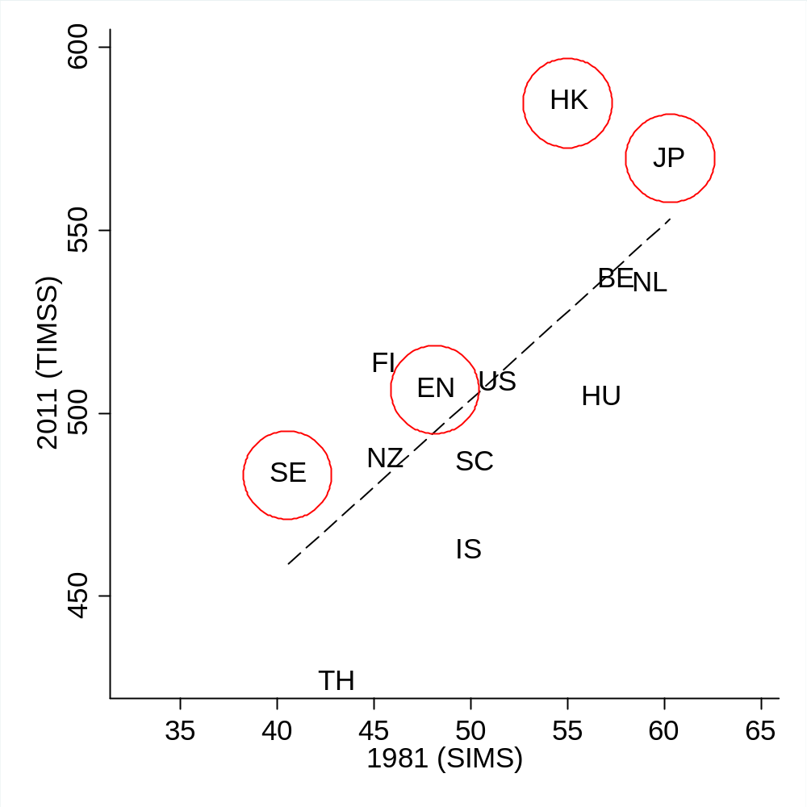
SIMS (1981) vs TIMSS (2011)
Has that much changed over the last 25-30 years?
East Asian (e.g. Japan / Hong Kong) countries at top of the maths rankings
England around the international average
Sweden does surprisingly poorly
Cross-country correlation
All countries = 0.72
Thailand excluded (outlier) = 0.66
Notes:
Note: TIMSS data from 2011 or closest available year (2007 or 2003)

Slide 33
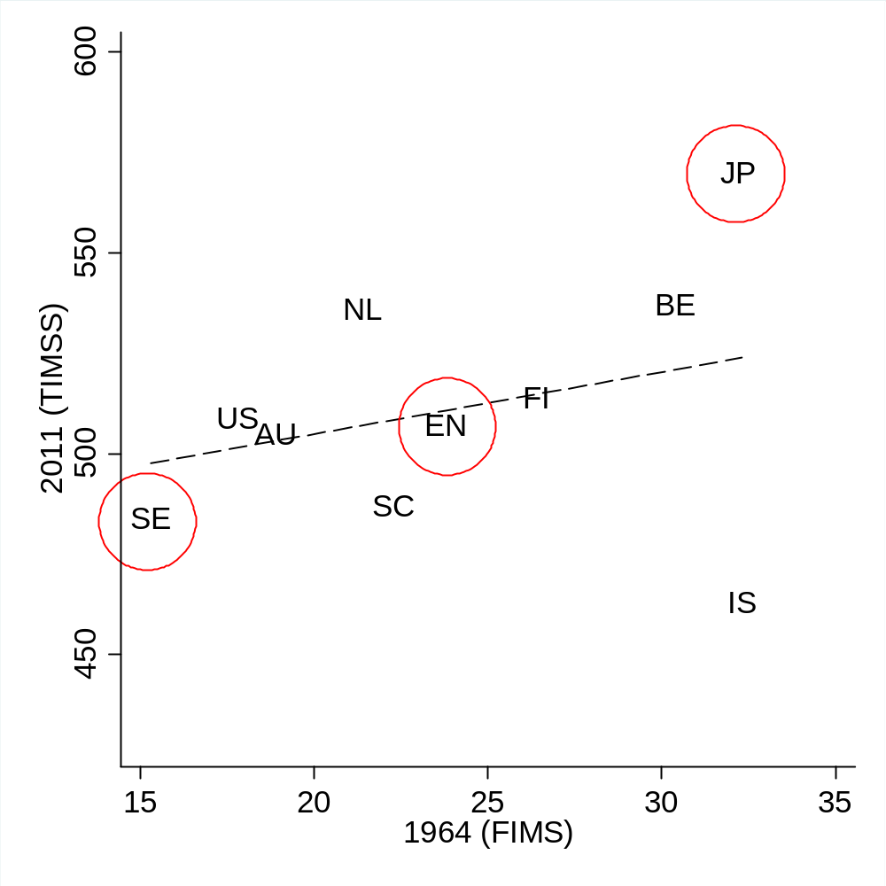
FIMS (1964) vs TIMSS (2011)
Has that much changed over the last 50 years?
East Asian (e.g. Japan) countries at top of the maths rankings
England around the international average
Sweden does surprisingly poorly
Cross-country correlation
All countries = 0.40
Israel excluded (outlier) = 0.78
Notes:
Note: TIMSS data from 2011 or closest available year (2007 or 2003)

Slide 34
2. Would China’s results be different if provinces other than Shanghai took part?

Slide 35
The issue….
12 Chinese provinces took part in PISA 2009…..
Only results for Shanghai (‘top performer’) were released….
Led to accusations of China cheating in PISA
People question how well China would do if entered as a whole country
The following slides may give you some idea……

Slide 36
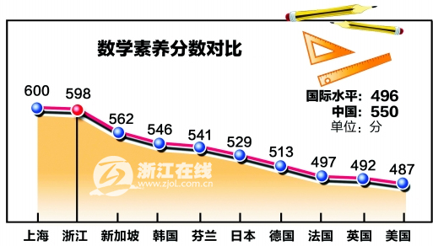
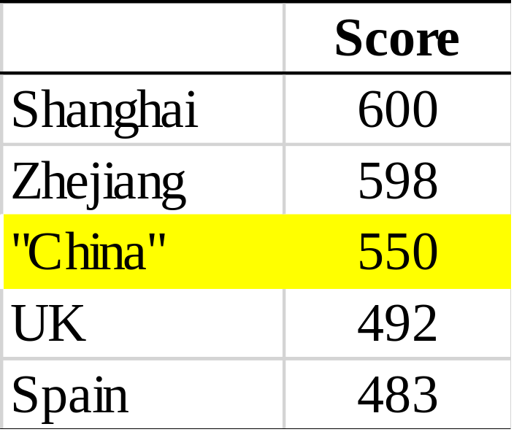
Mathematics (PISA 2009)
“China” = 12 province average
Source: https://translate.google.co.uk/translate?hl=en&sl=zh-CN&u=http://www.anhuinews.com/zhuyeguanli/system/2011/01/11/003654070.shtml&prev=search
Notes:
Source: https://translate.google.co.uk/translate?hl=en&sl=zh-CN&u=http://www.anhuinews.com/zhuyeguanli/system/2011/01/11/003654070.shtml&prev=search

Slide 37
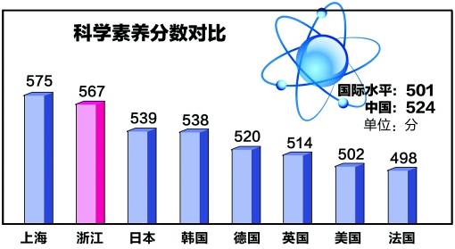
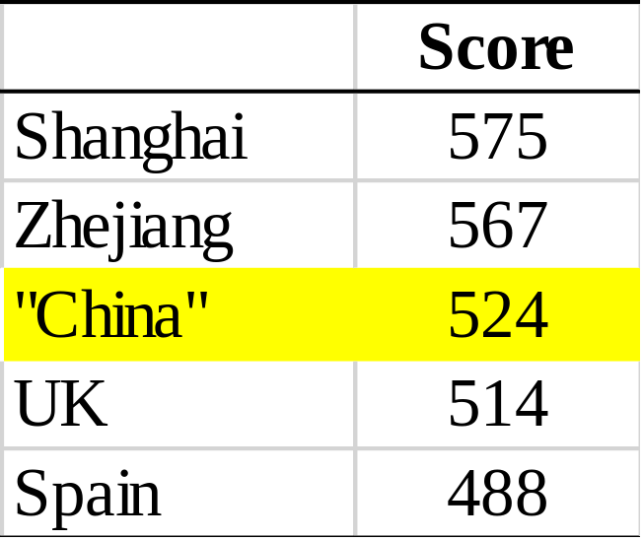
Science (PISA 2009)
“China” = 12 province average
Source: https://translate.google.co.uk/translate?hl=en&sl=zh-CN&u=http://www.anhuinews.com/zhuyeguanli/system/2011/01/11/003654070.shtml&prev=search
Notes:
Source: https://translate.google.co.uk/translate?hl=en&sl=zh-CN&u=http://www.anhuinews.com/zhuyeguanli/system/2011/01/11/003654070.shtml&prev=search

Slide 38
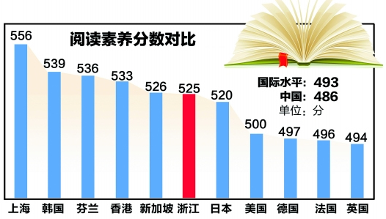
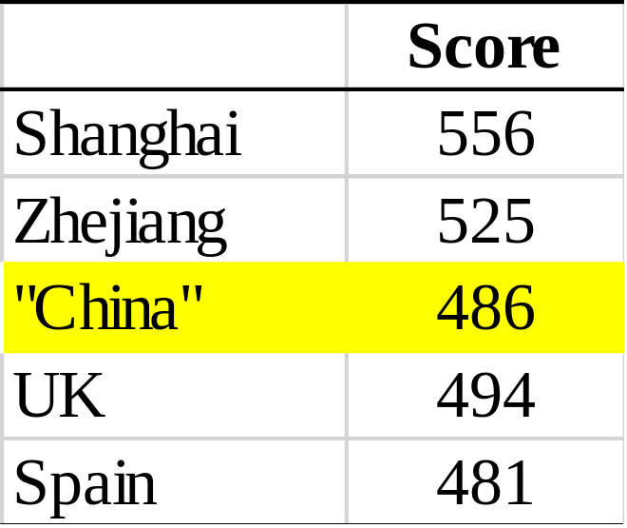
Reading (PISA 2009)
“China” = 12 province average
Source: https://translate.google.co.uk/translate?hl=en&sl=zh-CN&u=http://www.anhuinews.com/zhuyeguanli/system/2011/01/11/003654070.shtml&prev=search
Notes:
Source: https://translate.google.co.uk/translate?hl=en&sl=zh-CN&u=http://www.anhuinews.com/zhuyeguanli/system/2011/01/11/003654070.shtml&prev=search

Slide 39
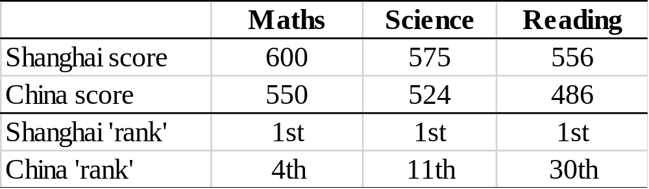
Summary
“China” = 12 province average
Source: https://translate.google.co.uk/translate?hl=en&sl=zh-CN&u=http://www.anhuinews.com/zhuyeguanli/system/2011/01/11/003654070.shtml&prev=search
Notes:
Source: https://translate.google.co.uk/translate?hl=en&sl=zh-CN&u=http://www.anhuinews.com/zhuyeguanli/system/2011/01/11/003654070.shtml&prev=search

Slide 40
3. Is East Asian ‘success’ about schooling systems? Or East Asian culture?

Slide 41
Second generation immigrants
Definition
Children who are born and raised in a Western country (e.g. Australia)……
……but whose parents are from East Asia
Intuition
They have been exposed to Western educational system (e.g. schools)…..
…..but also to East Asian ‘culture’ (through their parents)
How does this group of children do in PISA?

Slide 42
PISA scores: East versus West countries

Slide 43
PISA scores of East Asian immigrants in Western countries

Slide 44
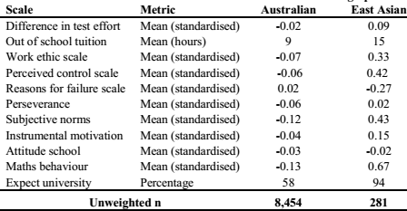
East Asian immigrants in Australia: descriptive

Slide 45
East Asian immigrants in Australia

Slide 46
Implications
Even when children of Eastern and Western heritage are exposed to the same schooling system……
……their PISA test scores differ significantly
Suggests PISA rankings more about culture than schools?
No silver bullets for educational policy?
Need sweeping change in society to education / parenting for PISA scores in Western countries to match those in the East?

Slide 47
4. Shanghai as the ‘world’s best schooling system’. But how much progress do pupils really make?

Slide 48
The issue….
PISA rankings often interpreted in terms of school / school system quality...
Andreas S: ‘What Asian schools can teach the rest of the world’
Can PISA really tell us this?
Minimum: how much do children progress during time at school?
Wide spread use of ‘value-added’ measures to judge school quality
PISA does not typically do this!

Slide 49
The intuition….
‘Start’ = Maths ability when child enters school
‘End’ = Maths ability when child leaves school
Children in Spain still behind Shanghai when they leave school……
….but they have reduced the achievement gap compared to school entry
They have made more progress during time in school…….
….suggesting Spanish schools may be better than those in Shanghai!

Slide 50
Issue: ‘Value added’ measures don’t exist in PISA
But, for some countries, we can get a proxy, for some economies.......
…..including Shanghai!
Relies on fact PISA samples children from multiple school grades
‘Fuzzy’ Regression Discontinuity Design (RDD)…
Gives an estimate of how much progress children make over one school year…..

Slide 51
RDD intuition
Impact of one additional year of schooling upon children’s PISA test scores = 40 points

Slide 52
RDD results for Shanghai
Actually very little going on around the discontinuity in Shanghai……
Notes:
My calculations PISA 2012 only (no 2009 data included)

Slide 53
RDD results for Chinese Taipei
Actually very little going on around the discontinuity in Shanghai……
Notes:
My calculations PISA 2012 only (no 2009 data included)

Slide 54
Summary of results
 | PISA points progress made over one academic year
 | Shanghai | Chinese Taipei
Reading | 2.9 | 0.8
Mathematics | 1.2 | 0.9
Science | -3.1 | -2.0
Key Implication
Children in Shanghai and Chinese Taipei actually make very little progress in secondary school………
….at least between grade 9 and grade 10
Notes:
Based on Andy Mac analysis. PISA 2009 and 2012 combined.

Slide 55
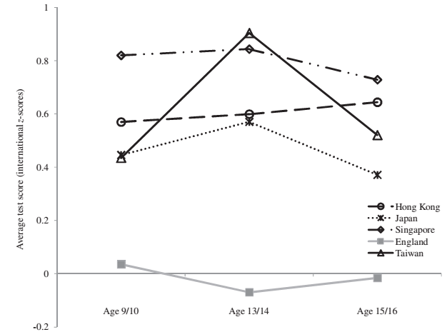
Other evidence on progress from PISA / TIMSS
Source
Jerrim and Choi (2014)

Slide 56
5. Is it because East Asian children are simply ‘more intelligent’?

Slide 57
The issue……
Is (highly) controversial!!
Basic premise: East Asian children are simply just smarter than other groups
They are more intelligent than other groups, so their high PISA scores (particularly in mathematics) should simply be expected…….
Vulgar to even say this aloud some people…..
…..others things it is simply obvious
NOT just internet nutcases (though there are a lot of those)…..
…There are serious (published) academic articles on this also……

Slide 58
Emails I have received from people……
“I'm a member of the British public who has watched with interest today the articles on your recent report and your interview.
The one angle I have not heard mentioned is that IQ levels vary considerably between the races and many researchers believe these differences have a significant genetic element. To be truly scientific we should consider all possibilities.
Policy and cultural forces of course should be part of the overall analysis, but I do not think it is unbiased to ignore a possible biological influence which could at least be a part of the mix and by ignoring it the study is not truly comprehensive.”

Slide 59
PISA scores versus ‘intelligence’ tests (IQ)
Source
Lynn and Meisenberg (2010).
Journal = Intelligence.
Impact factor > 3
Correlation = 0.9.
Countries with high PISA scores have the highest IQ......
Notes: Asian countries in red

Slide 60
Lets try to look in
Like I said – controversial!
But lets think about the argument some more anyway……
What I am going to do……
Look again at the second-generation East Asian immigrants in Australia….
Account for the argument that they may be “more intelligent”……
Do we still see East Asian child doing much better in school achievement?
If so, strong evidence East Asian children’s high achievement (e.g. PISA scores) more than due to just differences in IQ……

Slide 61
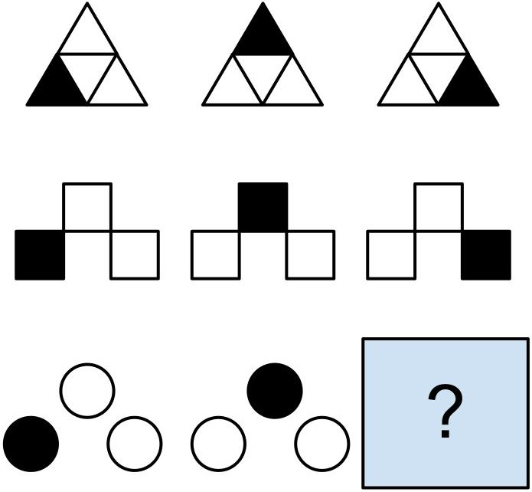
Measure of ‘fluid intelligence’……
‘The natural ability to solve problems, reason and remember’
Relatively uninfluenced by experience…..
‘is probably primarily determined by biological or genetic factors’
Source: Naime (2006). Psychology.
Notes:
https://books.google.co.uk/books?id=qY4FAAAAQBAJ&pg=PA332&lpg=PA332&dq=fluid+intelligence+natural+ability&source=bl&ots=6SqmTk33o5&sig=NbkyNWfzjGJxdtIz_m8jHffefc8&hl=en&sa=X&ved=0CDkQ6AEwBGoVChMIj-zp4c6CyAIVhIkaCh13Ngap#v=onepage&q=fluid%20intelligence%20natural%20ability&f=false

Slide 62
East Asian v native maths achievement gap at 8/9
Key points
Controlling for differences in ‘fluid intelligence’ only reduces Australian native vs East Asian gap by one third.
Large, statistically significant difference remains (0.4 standard deviations)
East Asian immigrants to Australia seem to make more progress than natives as well…..
Notes:
My calculations LSAC

Slide 63
Key implication
Even if you buy the argument that East Asian children are of higher intelligence than Western children…….
….it does not really explain that much of the difference in their academic achievement test scores!!

Slide 64
6. Do East Asian children really suffer negative consequences?

Slide 65
The issue……
CBS news
Children of ‘tiger parents’ develop more aggression and depression
Living science
‘Tiger parenting tough on kids’
BBC
The relentless pressure means Korea ... has one of the highest suicide rates of OECD countries
Deutsch29
‘South Korea, Its High PISA Scores, and Its Suicide App’
Aljazeera
‘South Korean students wracked with stress’
But what does the evidence actually tell us???
Notes:
http://www.livescience.com/18023-tiger-parenting-tough-kids.html
https://deutsch29.wordpress.com/2015/05/28/south-korea-its-high-pisa-scores-and-its-suicide-app/
https://www.google.co.uk/#q=PISA+Asia+suicide&start=10

Slide 66
PISA 2012: Child gets ‘very tense’ about maths homework
Notes:
Part of PISA anxiety scale…… My calculations PISA 2012

Slide 67
PISA 2012: Child worried will get poor grades….
Notes:
My calculations PISA 2012

Slide 68
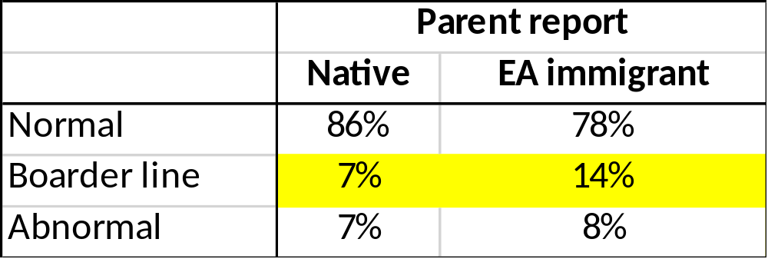
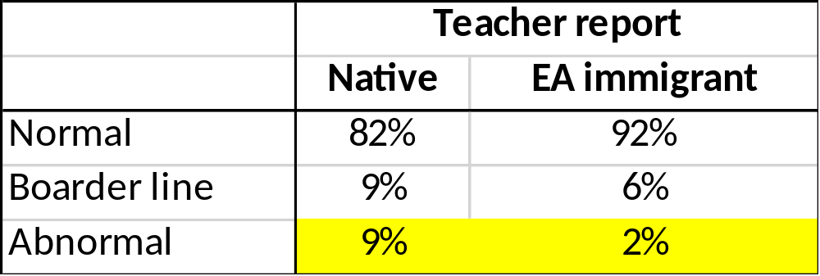
Behavioural problems (Australia)
Inconclusive!
Answer depends on whether you ask parents or teachers…
Notes:
Based upon SDQ. My calculations LSAC.

Slide 69
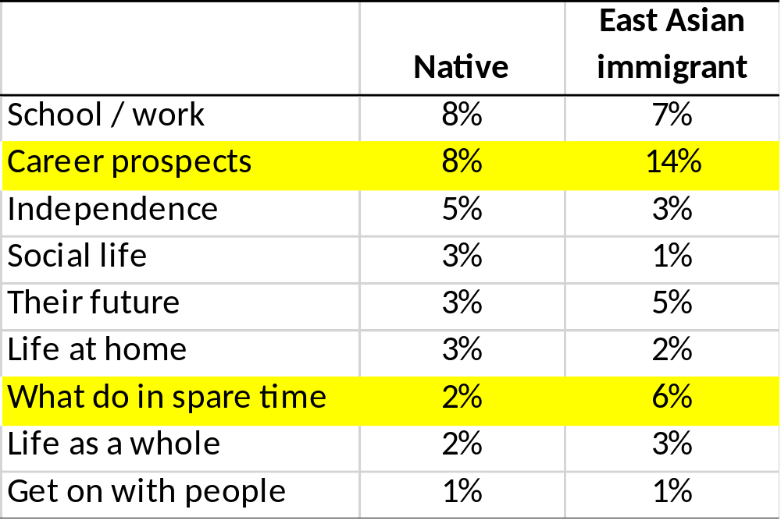
% of Australian teenagers who are unhappy in their life
Figures refer to the percent of 16/17 year olds who are unhappy at given aspect of their life….
Not a huge amount of difference…..
Notes:
May calculations LSAY

Slide 70
Conclusions
Six key take home messages

Slide 71
Six key take home messages
1. East Asian high educational achievement is not news!
2. ‘China’ unlikely to do as well as ‘Shanghai’ in PISA……
…….though probably still does pretty well (particularly maths)
3. East Asian culture clearly plays an important role
4. PISA scores ≠ quality of schooling system (little progress made in Shanghai..)
5. Its not all (or even mainly) about differences in ‘intelligence’…….
6. Less evidence of Asian children being unhappy than one might think……

