Slide 1

Preventing & dealing with depression at work: reducing the costs of depression, improving productivity
David McDaid
PSSRU, LSE Health & Social Care London School of Economics and Political Science
E-mail: d.mcdaid@lse.ac.uk
International Conference of the Areces Foundation
Madrid, June 14, 2016

Slide 2
Poor mental health and wellbeing have consequences for workplaces

Slide 3
Impacts in the workplace
Lost opportunities for innovation & creativity
Absenteeism
Presenteeism
Staff turnover
Adverse impacts on working relationships with colleagues; poor morale
Increased conflict in the workplace
Stigma and discrimination in the workplace
Increase in risk of poor physical health and injuries

Slide 4
Creativity, Innovation, Reputation
Potential benefits of positive mental wellbeing include:
Improved employer-employee dialogue
Better workplace performance
Encouraging creativity and innovation
Enhancing business reputation

Slide 5
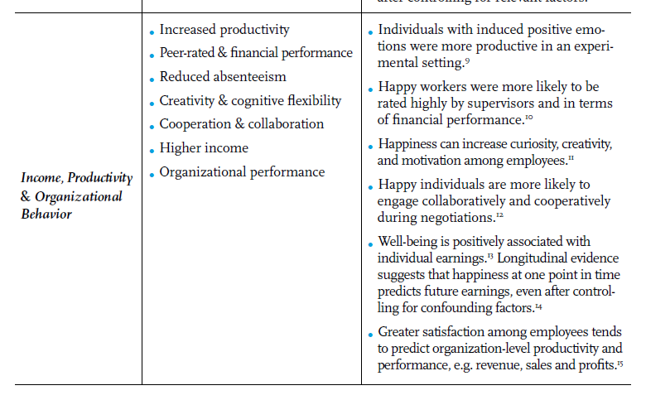
Benefits of positive wellbeing
Helliwell, Layard & Sachs (eds). World Happiness Report 2013

Slide 6
Survey on Wellness and Business Effectiveness (Dornan & Jane-Llopis 2010)
29,000 employees, 10 industries, 15 countries
Self report on attitudes, performance and conditions
72% who rated organisation highly for actively promoting physical and mental health also rated highly for encouraging creativity and innovation
Fourfold increase in creativity and innovation, compared with a sevenfold decrease in companies where health and wellbeing were perceived to be poorly managed
Poorly managed four times less likely to retain staff talent within a 12 month period

Slide 7
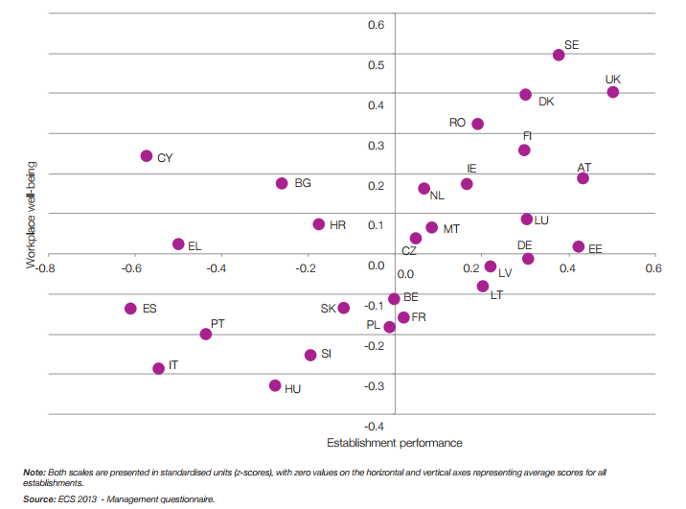
Company performance and workplace wellbeing: indices by country
Source: Eurofound Third European Company Survey 2015

Slide 8
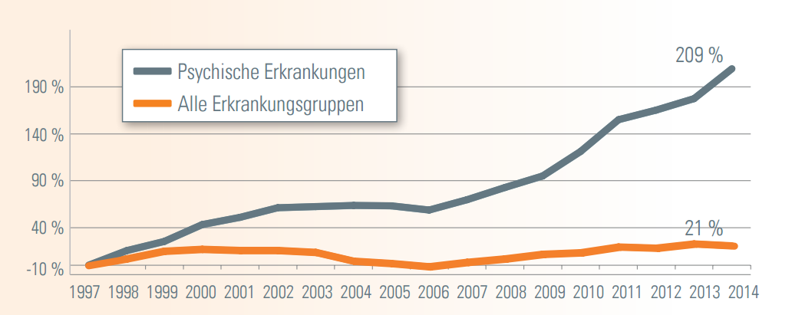
Reasons for absenteeism in a German health insurance fund
Depression, anxiety & stress
All health problems
DAK Gesundheit 2015

Slide 9
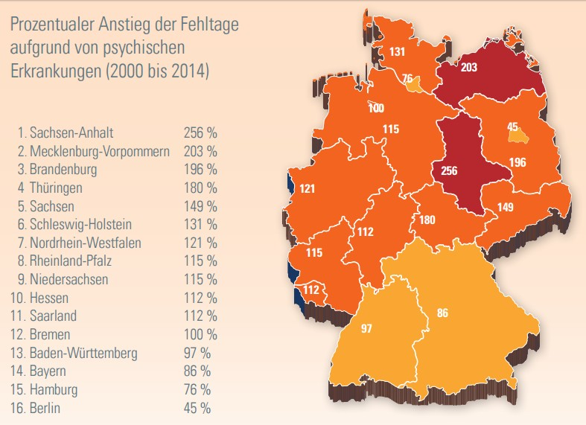
Percentage growth in sick leave days due to mental health problems 2000 - 2014
DAK Gesundheit 2015

Slide 10
Average rate per 100,000 employees of self-reported stress, depression or anxiety caused or made worse by current or most recent job, by occupation, for people working in the last 12 months, averaged 2011/12, 2013/14, 2014/15
Source: UK Health and Safety Executive 2016

Slide 11
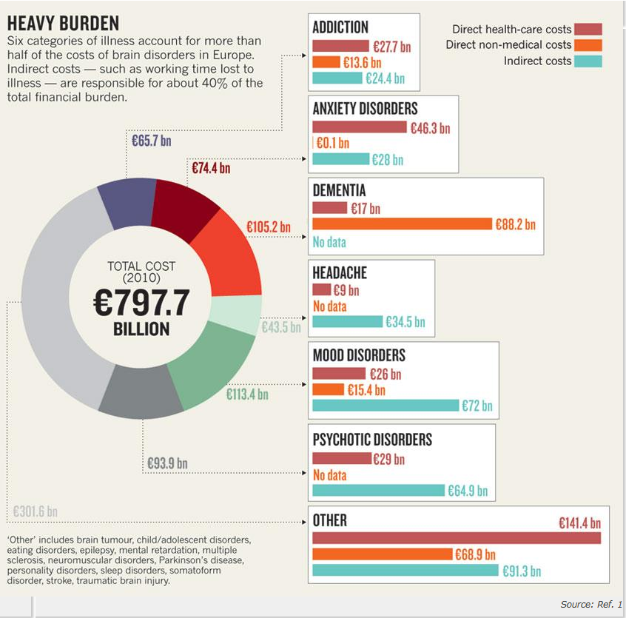
Major Economic Impact
Mood Disorders
€113 billion:
Health care : €26 billion
Other services: €15 billion
Productivity: €72 billion
Gustavsson, A. et al. Eur. Neuropsychopharmacol. 21, 718-779 (2011) and Smith K. Nature 2011

Slide 12
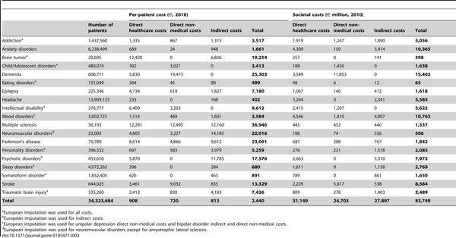

Number of people, per-patient cost and societal cost by type of costs for all disorders in Spain 2010.
Mood Disorders: €10.7 billion
Health care costs: €4.5 billion
Other service costs: €1.4 billion
Productivity losses: €4.8 billion
Parés-Badell O, Barbaglia G, Jerinic P, Gustavsson A, Salvador-Carulla L, et al. (2014) Cost of Disorders of the Brain in Spain. PLoS ONE 9(8): e105471. doi:10.1371/journal.pone.0105471
http://journals.plos.org/plosone/article?id=info:doi/10.1371/journal.pone.0105471

Slide 13
Cost of absenteeism in Great Britain
11.4 million days lost to stress/depression in 2008/2009 in GB
46% of all days at work lost to illness
Average length of absenteeism 28 days per case
Conservative costs of work related absenteeism estimated at £750 million for all UK (Foresight 2008)
All absenteeism due to stress/depression as high as £4 billion per annum

Slide 14
The ‘business cost’ consequences of mental health needs in the UK
Absenteeism (UK)
The average employee has 7 ‘sick days’ off per year … and 40% are for mental health problems
Cost to business = £8.4 billion
‘Presenteeism’ (UK)
Mental health problems can make people less productive in the workplace
Cost to business = £15.1 billion
Staff turnover (UK)
Replacing staff who leave because of mental ill-health
Cost to business = £2.4 billion
Sainsbury Centre for Mental Health, Policy Paper, 2007

Slide 15
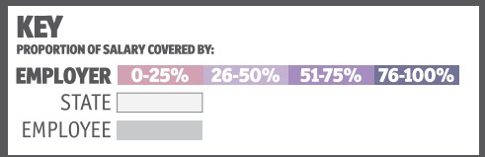
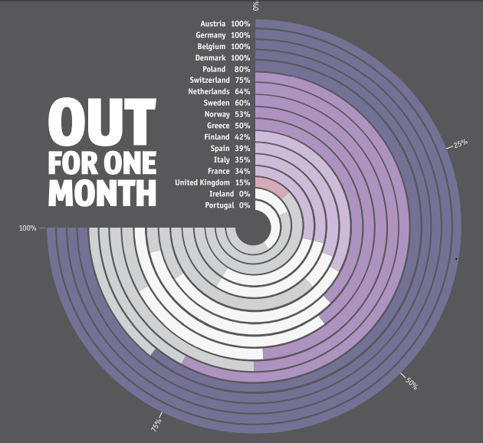
Major Cause of Early Retirement
Source: Economist Intelligence Unit 2014

Slide 16
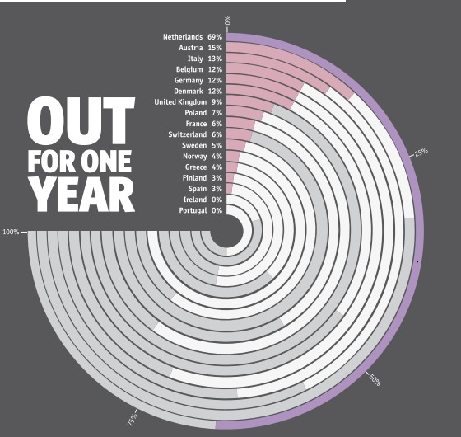
Major Cause of Early Retirement
Source: Economist Intelligence Unit 2014

Slide 17
Impacts in workplaces greater during economic shocks

Slide 18
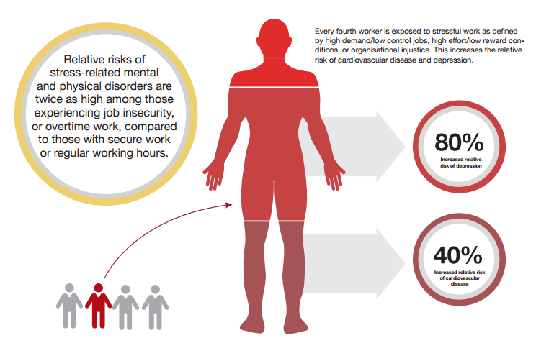
Impacts of job insecurity
Source: Siegrist, McDaid , Freire-Gabal, Levi et al – ‘Santiago Declaration, 2013’

Slide 19
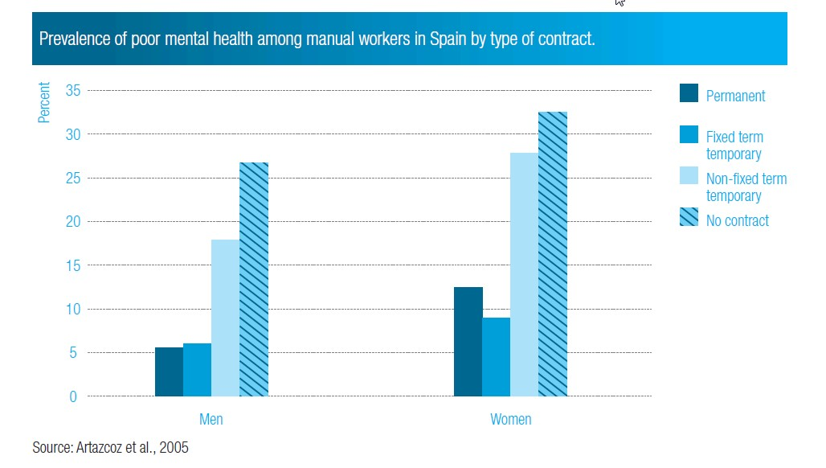
In Commission on Social Determinants of Health, 2008

Slide 20
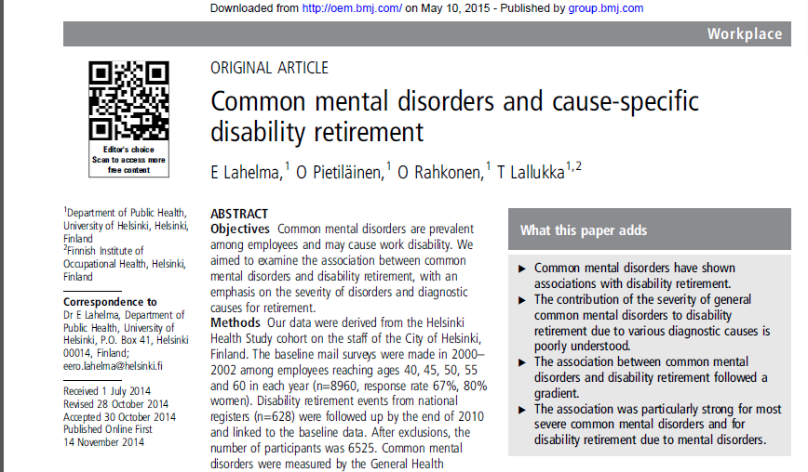
Hazard ratio for retiring as a result of mental health problems 3 times greater than for general disability

Slide 21
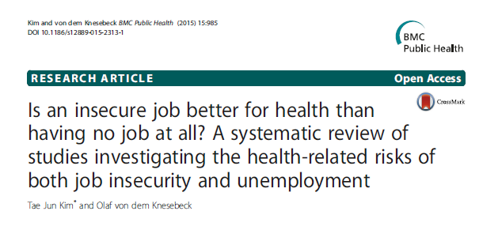
Review of studies looking at both job insecurity and unemployment as risk factors to health and mental health
13 studies identified
Consistently job insecurity as great a risk as unemployment – minimal differences in effects by gender
Both Job Insecurity and Unemployment associated with risks to mental health; more somatic symptoms seen with job insecurity
Kim and von dem Knesebeck BMC Public Health (2015) 15:985

Slide 22
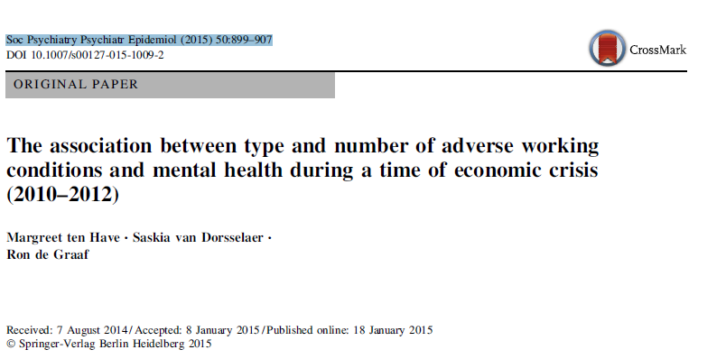
4,000 people from NEMESIS-2 Study (Netherlands Mental Health Survey and Incidence Study-2)
Low job security doubled chance of mental health symptoms & mental disorders
Workers in poorest quality jobs, had 3 to 5 times higher chance of mental disorders than those in most optimal jobs
Having a poor quality job was not associated with better health outcomes than being unemployed

Slide 23
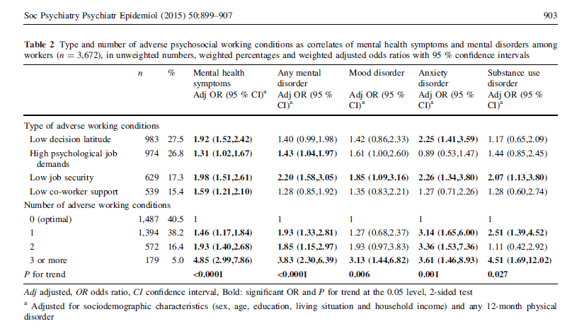
Ten Have et al Soc Psychiatry Psychiatr Epidemiol (2015) 50:899–907

Slide 24
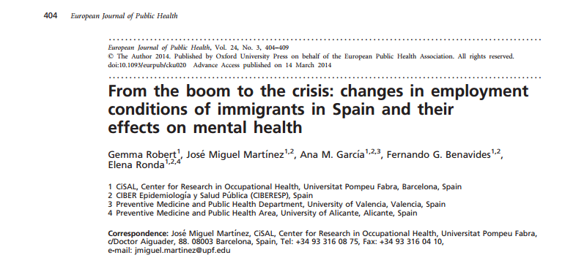

Slide 25
Migrant status, employment & mental health
Follow up survey of 318 workers from Colombia, Ecuador, Morocco and Romania residing in Spain.
Increased risk of poor mental health in workers:
  lost jobs (OR = 3.62, 95%CI: 1.64–7.96),
  working hours increased (aOR = 2.35, 95%CI: 1.02–5.44),
  monthly income decreased (aOR = 2.75, 95%CI: 1.08–7.00)
Decreased risk in workers who were able to register with Spanish social security system
Robert et al 2014

Slide 26
Impacts of business downsizing, redundancy and being a survivor in workplace

Slide 27
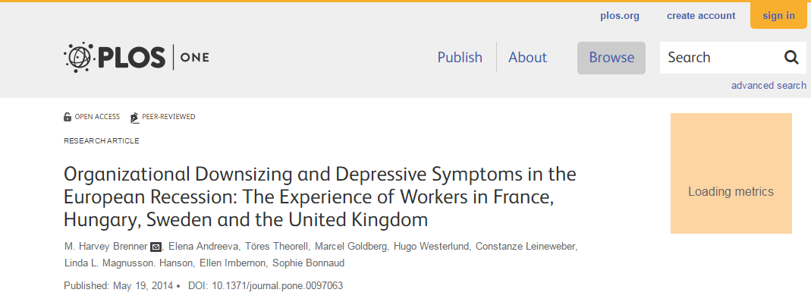

Slide 28
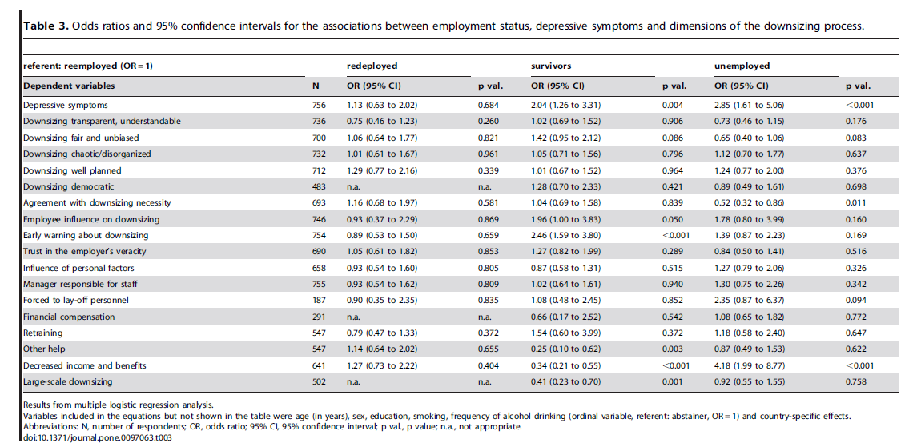
Impacts of downsizing
Odds Ratios for Depressive Symptoms
Redeployment 1.13
Survivors 2.04
Unemployment 2.85
Brenner et al 2014

Slide 29
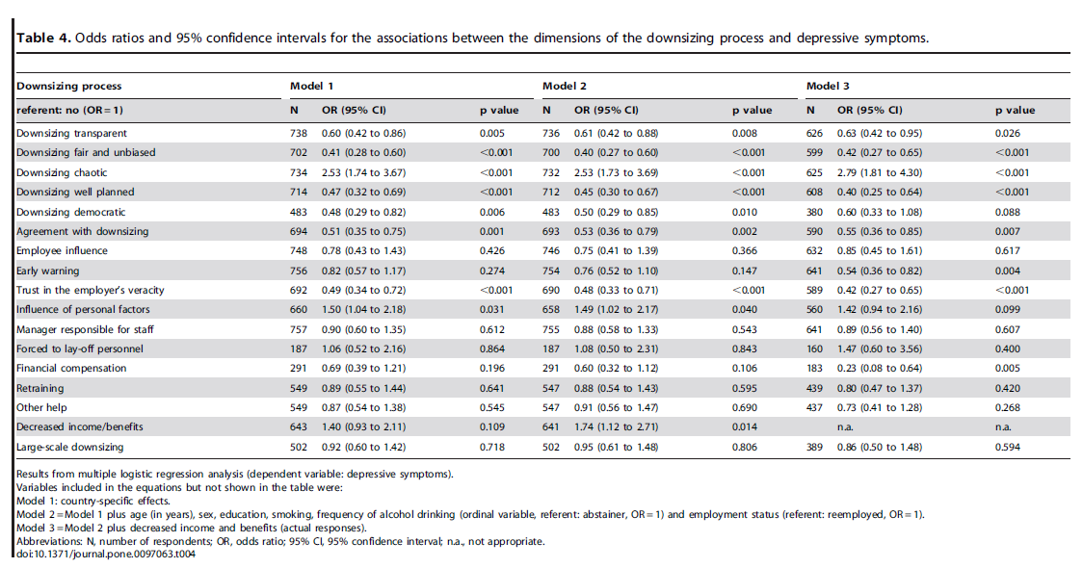
Impact of downsizing process on depression
Brenner et al 2014

Slide 30
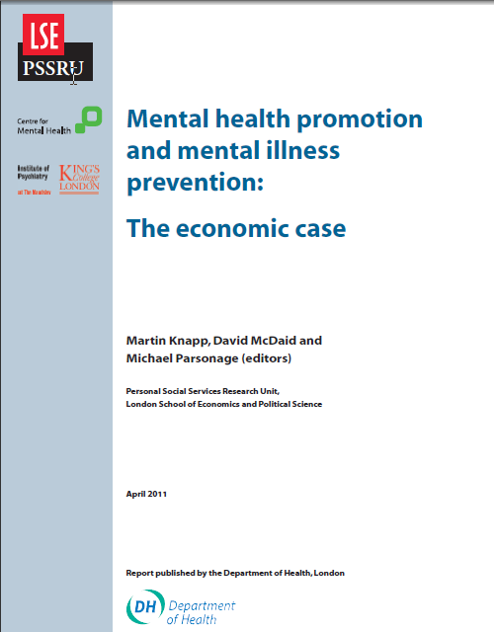
Review of 15 potential actions for promotion and prevention
Calculation of return on investment if implemented at England level
Review of effectiveness literature
Local cost data attached
Decision analytical models constructed
Includes workplace wellbeing
Updated economic return on investment available later in 2016

Slide 31
Workplace well-being programmes
Target - working-age adult population accessed through their place of employment
Multi-component health-promoting programme, including health risk appraisal and information and advice tailored to employee’s readiness to change health-related behaviours. Cost = £80 employee p.a.
Outcomes – Strong evidence from US and Australia. Some evidence in UK of reduced stress levels and absenteeism, and improved productivity (Mills et al 2007).
Economic pay-offs:
Reductions in sickness absence and presenteeism; reduced costs of avoidable mental health problems to NHS
Total savings = £9.69 for every £1 invested, mostly accruing to employers
McDaid et al, in Knapp et al DH report 2011; Mills et al Am J Health Promotion 2007

Slide 32
Case Study: British Telecom
Company wide mental health strategy
Level 1: Mental health promotion information, campaigns, road shows, manager training
Level 2: Stress risk assessment and early intervention
Level 3: Services and support for those who develop or have pre-existing mental health problems. Counselling, psychological therapy. Help with rehab and work adjustments.
21.5% reduction in annual mental health sickness rate
https://responsibilitydeal.dh.gov.uk/deliveryplans/?dp=3712

Slide 33
Importance of thinking about effective implementation

Slide 34


Available via: http://ec.europa.eu/social/main.jsp?catId=716&langId=en

Slide 35
Investment in Efforts in Enterprises and MS
Awareness campaigns
Training in enterprises
Training of health and safety inspectors
Monitoring implementation
National adaptations of EU legislation (€0.5 million in UK)
Development & adaptation of standards
Support for active inclusion in work
Collaboration between occupational and mainstream health systems
Leka, Jain, Houtman, McDaid, Park, De Broeck & Wynne 2014

Slide 36
To sum up….
Much workplace mental health promotion likely to be cost effective
But much is still unknown – careful evaluation in partnership with enterprise required
Some scope to retrospectively add cost to effectiveness studies
Work is beneficial to health and esteem of individuals
Major benefits to business – but how to realise in small and medium sized enterprise
Major benefits to govt if individuals remain economically active paying taxes and contributing to economic output

