Slide 1
Complexity in IFRS, diminishing returns and differential reporting
Professor Peter Walton
Fundación Ramón Areces
Universidad Autónoma de Madrid
11 February 2016

Slide 2
Outline
● Complexity of standards, and disclosure overload
● Diminishing returns and Pareto principle
● The analyst paradox
● The effect of complexity on markets
● Differential reporting
● Smaller listed companies

Slide 3
Complexity and disclosure overload
Sir David Tweedie:
‘Anyone who says they understand IAS 39 has not read it carefully.’

Slide 4
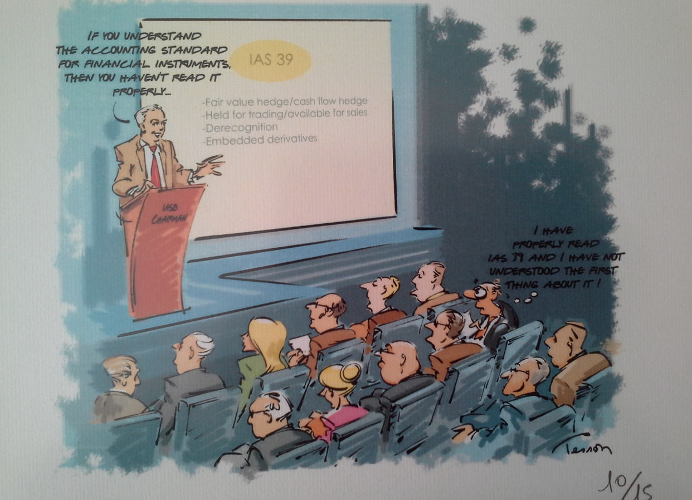

Slide 5
Complexity and disclosure overload
EFRAG (2014) Complexity Bulletin:
Complexity in financial reporting refers primarily to the difficulty for:
1. Investors to understand the economic substance of a transaction or event and the overall financial position and results of a company;
2. Preparers to properly apply generally accepted accounting principles ... And communicate the economic substance of a transaction or event and the overall financial position and results of a company; and
3. Other constituents to audit, analyze, and regulate a company’s financial reporting

Slide 6
Complexity and disclosure overload
EFRAG Complexity Bulletin:
Unavoidable complexity – business transactions are increasingly sophisticated and difficult to understand
Avoidable complexity – unnecessarily complex accounting or disclosure requirements

Slide 7
Complexity and disclosure overload
Current IFRS are stacked with disclosure requirements and new ones are added every time a new or amended standard is adopted.
These disclosures are justified on the basis that they provide users of the financial statements with information that is relevant to economic decisions they make.
However, that assertion remains largely untested
(EFRAG 2014 Towards a Disclosure Framework p15)

Slide 8
Diminishing returns
Law of diminishing returns (also called law of variable proportions, principle of diminishing marginal productivity, or diminishing marginal returns) is the decrease in the marginal (incremental) output of a production process as the amount of a single factor of production is incrementally increased, while the amounts of all other factors of production stay constant.

Slide 9
Pareto principle
The Pareto principle (also known as the 80–20 rule) states that, for many events, roughly 80% of the effects come from 20% of the causes
Effects
Causes

Slide 10
The analyst paradox
Singh, M (2015) Addressing Financial Reporting Complexity: Investor Perspectives, CFA Institute
Comparability is essential to understand financial statements
Loss of information leads to an increase in the cost of capital

Slide 11
The analyst paradox
EFRAG (2013) The role of the business model in financial reporting:
In some standards the business model impacts upon recognition and measurement
Investors need to understand the business model in order to assess how and how efficiently value is being created
Enhanced Disclosure Task Force/Financial Stability Board
- Best disclosure is business model, risks inherent in it, and how company manages them

Slide 12
The analyst paradox
● Analysts say they need comparability
● They say they need more information
● But the more information they have, the more the business model is revealed, and the less comparable is the financial information

Slide 13
The analyst paradox
Do analysts use the information provided?
Most analysts are not trained in financial reporting
In the USA and UK they are expected to look at the ‘preliminary announcement’ and provide comment within hours
They only see the full annual filing some time later
Research evidence of use difficult to collect (but see ICAS/EFRAG study)

Slide 14
The analyst paradox
Implications for standard-setting:
standard-setters provide information that analysts do not or cannot use?
Standards could be simplified

Slide 15
Effect of complexity on markets
● Complexity is a disincentive to private companies to list
Increased cost of internal staff, systems, audit
Shareholders may not understand information
Preparers hate to change their accounting
Fear unintended consequences
● Market will shrink if no new entrants
Some companies disappear through takeover etc. (see Doidge et al 2015: high delists, low new lists)
Long term leads to less investor choice

Slide 16
Effect of complexity on markets
Complex accounting rules distort the accounting profession
There is polarisation between members of international networks and smaller firms
This is exacerbated by the complexity of IFRS – need a number of IFRS clients to justify training cost of staff
IFRS are constantly changing and therefore maintenance of knowledge base is onerous

Slide 17
Effect of complexity on markets
Implications for standard-setters:
Simpler companies need simpler standards
Problem could be addressed by differential reporting, having simpler rules for simpler listed companies

Slide 18
Differential reporting
● Historically opposed by regulators and accountants
● Why should the way you account for a transaction be dependent on the nature of the entity?
but
● Economic impact is different (what is decision-useful?)
● Different business models
● Materiality consideration implies differential
● Impacts staff training requirements, profession

Slide 19
Differential reporting
● Differential disclosure introduced by Fourth Directive
- Now a few recognition and measurement derogations in 2013 Accounting Directive
● UN report TD/B/COM.2/ISAR/9 Accounting by small and medium-sized entities (2000)
- Should be range of comprehensive bases of accounting to allow small businesses to expand in series of small steps
● IFRS for SMEs issued in 2009
● Private Company Council formed in 2012
- In conjunction with FASB produces simplifications of US GAAP

Slide 20
Differential reporting
Difficulties with prescribing differential rules:
● Determining the scope
Size is not necessarily a good screen
Difficult to identify characteristics
Different needs between industrialised economies and developing economies
● Determining what transactions are covered
Pension plans
Cash flow statements
Financial instruments
Leases

Slide 21
Smaller listed companies
● So far the IASB draws a clear line between ‘publicly accountable’ entities and the rest
● Recently reiterated in submission to European Commission on Capital Markets Union
but
● Submissions on IFRS for SMEs frequently ask for its use to be allowed for smaller listed companies
● Commission wants IFRS-related simplification for multi-lateral trading facilities to encourage smaller companies to raise finance from markets

Slide 22
Smaller listed companies
Research evidence:
Difficult to draw a dividing line where differential reporting could work
Large international companies at one extreme, small, national companies at other, but in-between?
Swiss solution: two markets

Slide 23
Smaller listed companies
Policy issues:
● There should be a graduated set of steps between comprehensive bases of accounting
● This would reduce size of steps and cost, encourage more companies to expand
● Any economy needs growth and this will frequently come from small entities
● Would produce a less polarised accounting profession

Slide 24
Any questions, comments?

Slide 25
Other issues
● The funding of the IASB
● The role of the ‘European public good’
● Is the IASB better off without US adoption?

