Slide 1
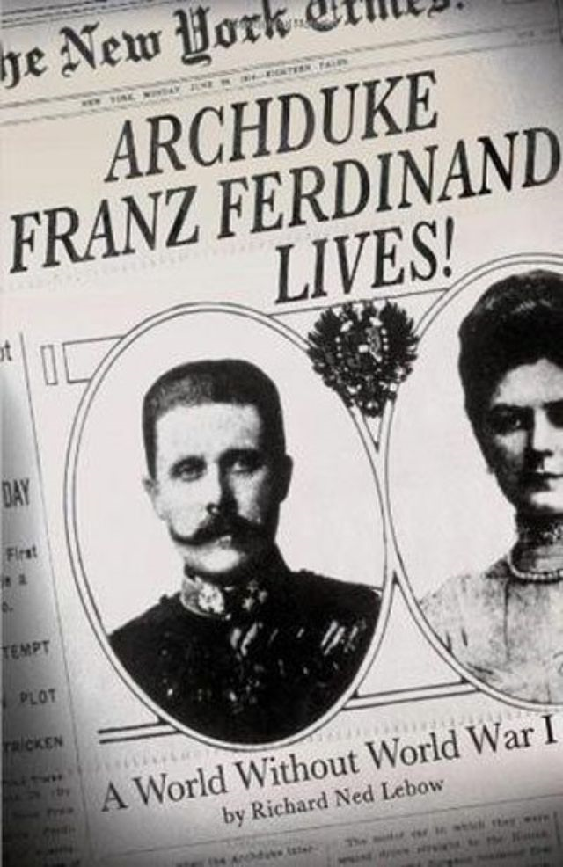

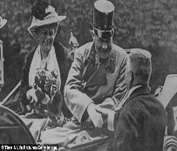
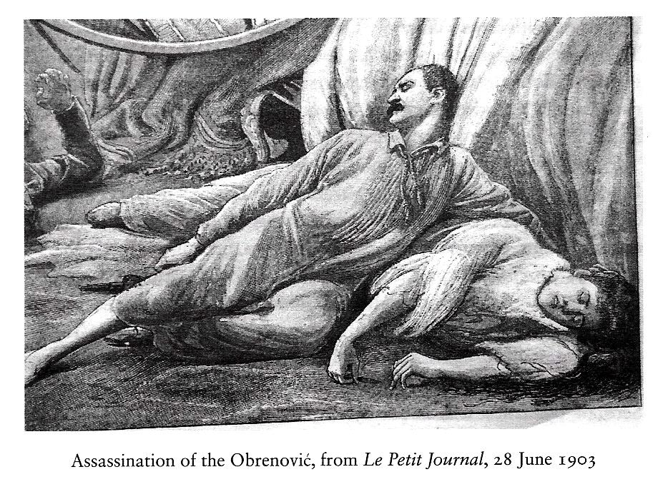
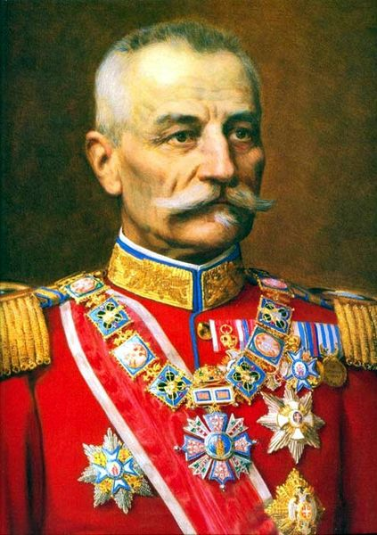
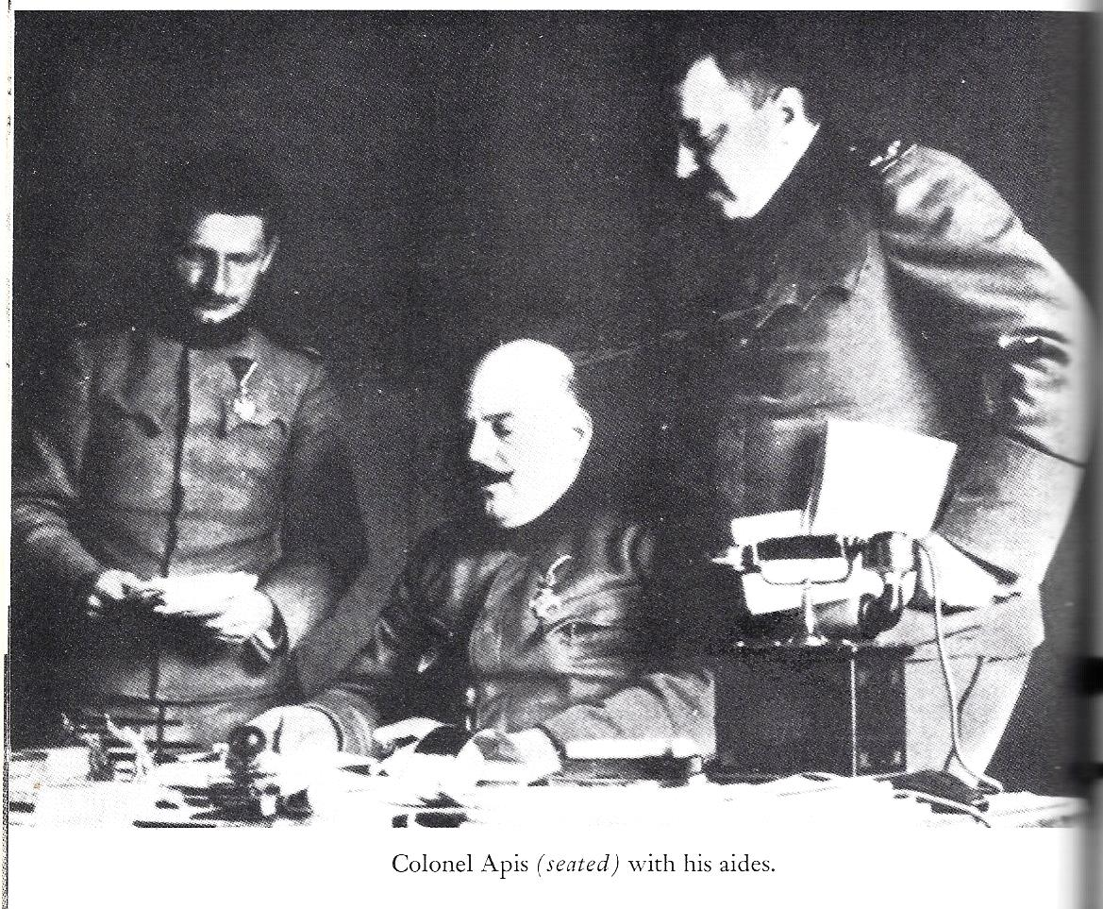
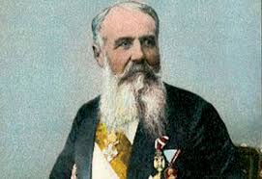
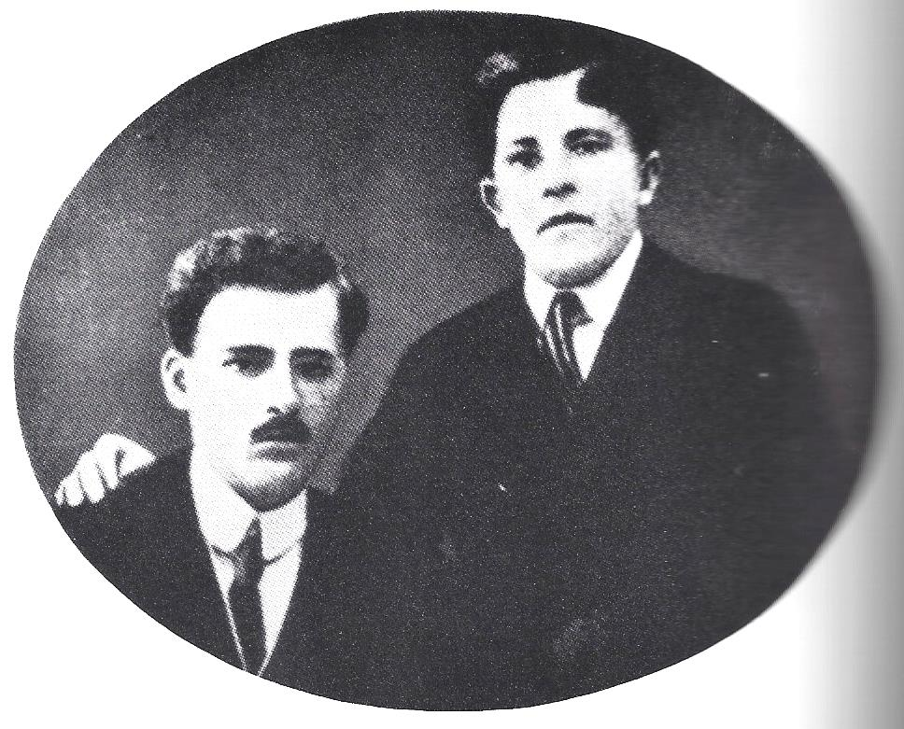
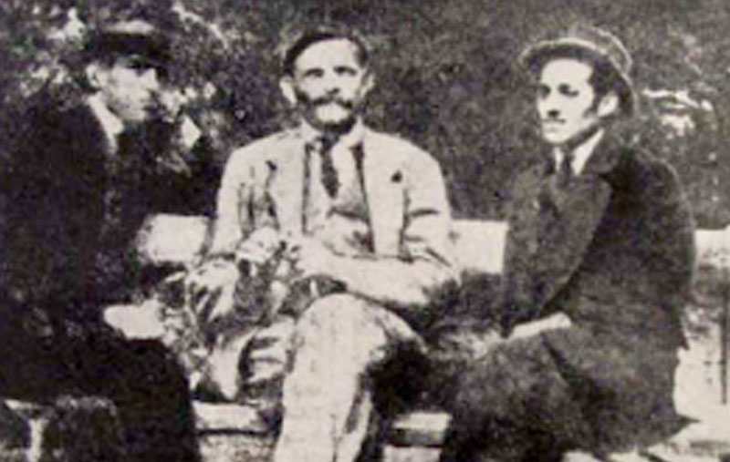
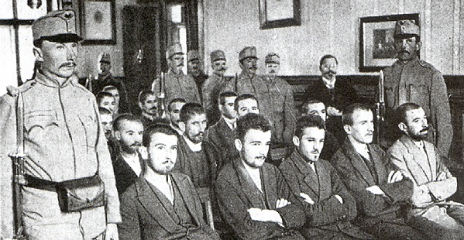
Archduke
Franz Ferdinand
Gavrilo Princip
Assassin
Archduke,
Duchess
King Alexander, Queen Draga
Obrenović
King Petar
Karadjordjević
Dragutin Dimitriević
‘Apis'
Head of Black Hand
Nikola Pašić
Prime Minister
Nedeljko
Čabrinović
Assassin
Trifko Grabež
Assassin
Danilo Ilić
Assassin

Slide 2
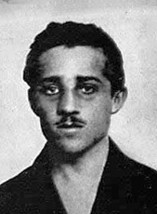
Archduke
Franz Ferdinand
Gavrilo Princip
Assassin
Archduke,
Duchess
King Alexander, Queen Draga
Obrenović
King Petar
Karadjordjević
Dragutin Dimitriević
‘Apis'
Head of Black Hand
Nikola Pašić
Prime Minister
Nedeljko
Čabrinović
Assassin
Trifko Grabež
Assassin
Danilo Ilić
Assassin

Slide 3

Archduke
Franz Ferdinand
Gavrilo Princip
Assassin
Archduke,
Duchess
King Alexander, Queen Draga
Obrenović
King Petar
Karadjordjević
Dragutin Dimitriević
‘Apis'
Head of Black Hand
Nikola Pašić
Prime Minister
Nedeljko
Čabrinović
Assassin
Trifko Grabež
Assassin
Danilo Ilić
Assassin

Slide 4
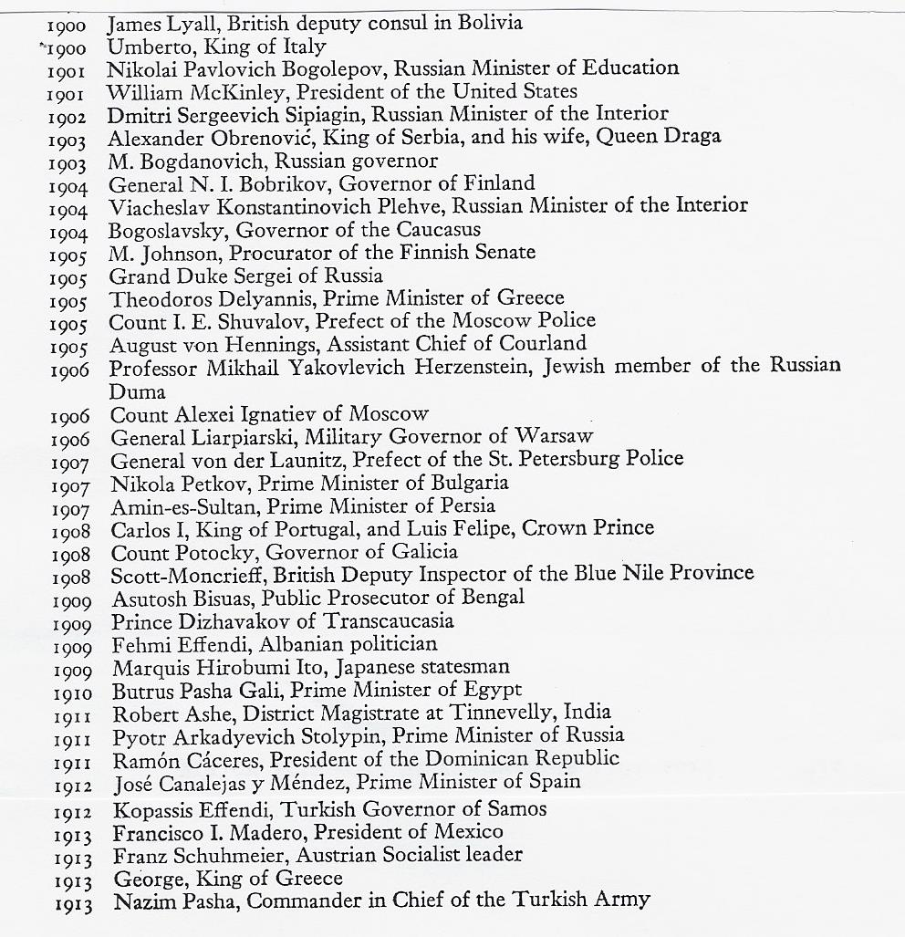
Major Assassinations 1900-1913

Slide 5
The murdered
King Alexander and Queen Draga
Archduke
Franz Ferdinand
Gavrilo Princip
Assassin
Archduke,
Duchess
King Alexander, Queen Draga
Obrenović
King Petar
Karadjordjević
Dragutin Dimitriević
‘Apis'
Head of Black Hand
Nikola Pašić
Prime Minister
Nedeljko
Čabrinović
Assassin
Trifko Grabež
Assassin
Danilo Ilić
Assassin

Slide 6
            King Petar Karadjordjević
Archduke
Franz Ferdinand
Gavrilo Princip
Assassin
Archduke,
Duchess
King Alexander, Queen Draga
Obrenović
King Petar
Karadjordjević
Dragutin Dimitriević
‘Apis'
Head of Black Hand
Nikola Pašić
Prime Minister
Nedeljko
Čabrinović
Assassin
Trifko Grabež
Assassin
Danilo Ilić
Assassin

Slide 7
Colonel Dragutin Dimitriević aka Apis
Archduke
Franz Ferdinand
Gavrilo Princip
Assassin
Archduke,
Duchess
King Alexander, Queen Draga
Obrenović
King Petar
Karadjordjević
Dragutin Dimitriević
‘Apis'
Head of Black Hand
Nikola Pašić
Prime Minister
Nedeljko
Čabrinović
Assassin
Trifko Grabež
Assassin
Danilo Ilić
Assassin

Slide 8
Nikola Pašić
Archduke
Franz Ferdinand
Gavrilo Princip
Assassin
Archduke,
Duchess
King Alexander, Queen Draga
Obrenović
King Petar
Karadjordjević
Dragutin Dimitriević
‘Apis'
Head of Black Hand
Nikola Pašić
Prime Minister
Nedeljko
Čabrinović
Assassin
Trifko Grabež
Assassin
Danilo Ilić
Assassin

Slide 9
The Black Hand’s Oath of Initiation
I [name] in joining the organisation Union or Death swear
by the sun that warms me, by the earth that nourishes me,
before God, by the blood of my ancestors, on my honour and on my life
that I will from this moment until my death be faithful
to the laws of this organisation and that I will always be ready
to make any sacrifice for it.... I swear before God,
on my honour and my life, that I will take all the secrets
of this organisation into my grave with me. May God and my comrades
in the organisation be my judges if... I should ever violate this oath.

Slide 10
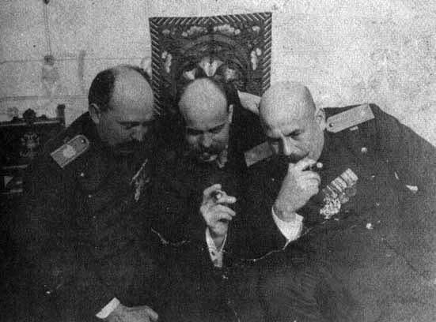
Apis (on the right) the congenital conspirator
Archduke
Franz Ferdinand
Gavrilo Princip
Assassin
Archduke,
Duchess
King Alexander, Queen Draga
Obrenović
King Petar
Karadjordjević
Dragutin Dimitriević
‘Apis'
Head of Black Hand
Nikola Pašić
Prime Minister
Nedeljko
Čabrinović
Assassin
Trifko Grabež
Assassin
Danilo Ilić
Assassin

Slide 11
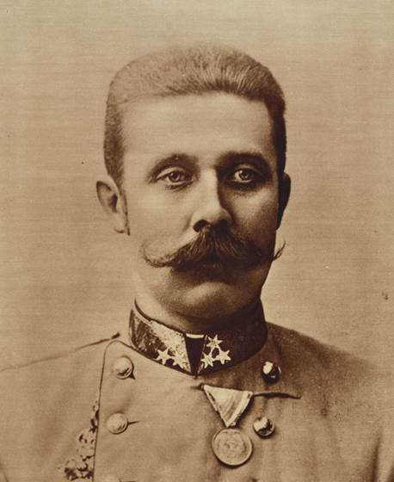
Archduke Franz Ferdinand
Archduke
Franz Ferdinand
Gavrilo Princip
Assassin
Archduke,
Duchess
King Alexander, Queen Draga
Obrenović
King Petar
Karadjordjević
Dragutin Dimitriević
‘Apis'
Head of Black Hand
Nikola Pašić
Prime Minister
Nedeljko
Čabrinović
Assassin
Trifko Grabež
Assassin
Danilo Ilić
Assassin

Slide 12
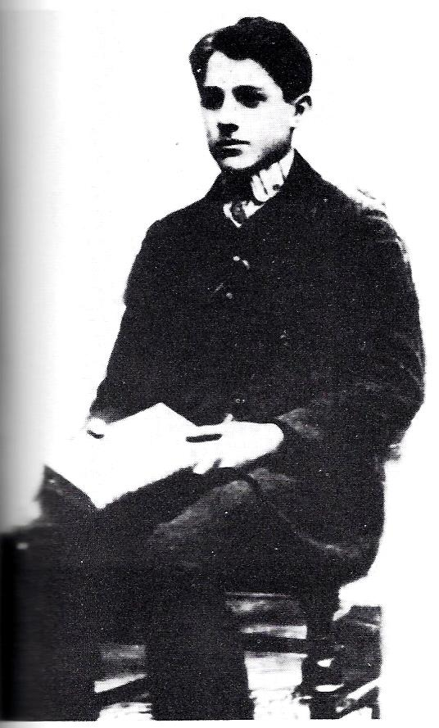
Gavrilo Princip aged 16
Archduke
Franz Ferdinand
Gavrilo Princip
Assassin
Archduke,
Duchess
King Alexander, Queen Draga
Obrenović
King Petar
Karadjordjević
Dragutin Dimitriević
‘Apis'
Head of Black Hand
Nikola Pašić
Prime Minister
Nedeljko
Čabrinović
Assassin
Trifko Grabež
Assassin
Danilo Ilić
Assassin

Slide 13
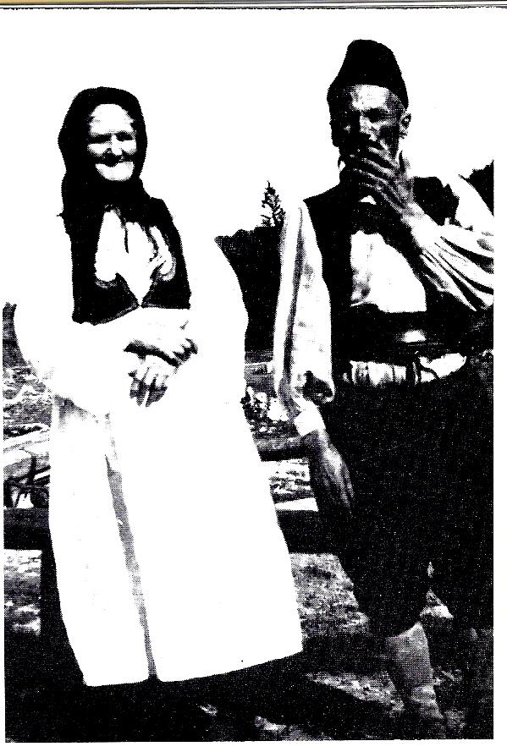
Princip’s Parents
Archduke
Franz Ferdinand
Gavrilo Princip
Assassin
Archduke,
Duchess
King Alexander, Queen Draga
Obrenović
King Petar
Karadjordjević
Dragutin Dimitriević
‘Apis'
Head of Black Hand
Nikola Pašić
Prime Minister
Nedeljko
Čabrinović
Assassin
Trifko Grabež
Assassin
Danilo Ilić
Assassin

Slide 14
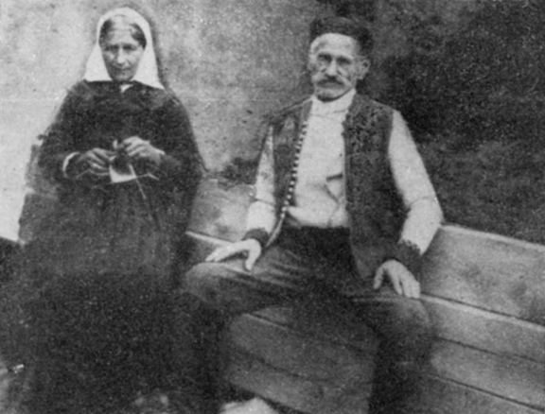
Archduke
Franz Ferdinand
Gavrilo Princip
Assassin
Archduke,
Duchess
King Alexander, Queen Draga
Obrenović
King Petar
Karadjordjević
Dragutin Dimitriević
‘Apis'
Head of Black Hand
Nikola Pašić
Prime Minister
Nedeljko
Čabrinović
Assassin
Trifko Grabež
Assassin
Danilo Ilić
Assassin

Slide 15
Nedeljko Čabrinović (Left)
Archduke
Franz Ferdinand
Gavrilo Princip
Assassin
Archduke,
Duchess
King Alexander, Queen Draga
Obrenović
King Petar
Karadjordjević
Dragutin Dimitriević
‘Apis'
Head of Black Hand
Nikola Pašić
Prime Minister
Nedeljko
Čabrinović
Assassin
Trifko Grabež
Assassin
Danilo Ilić
Assassin

Slide 16
Trifko Grabež, Djuro Šarac and Gavrilo Princip
Archduke
Franz Ferdinand
Gavrilo Princip
Assassin
Archduke,
Duchess
King Alexander, Queen Draga
Obrenović
King Petar
Karadjordjević
Dragutin Dimitriević
‘Apis'
Head of Black Hand
Nikola Pašić
Prime Minister
Nedeljko
Čabrinović
Assassin
Trifko Grabež
Assassin
Danilo Ilić
Assassin

Slide 17
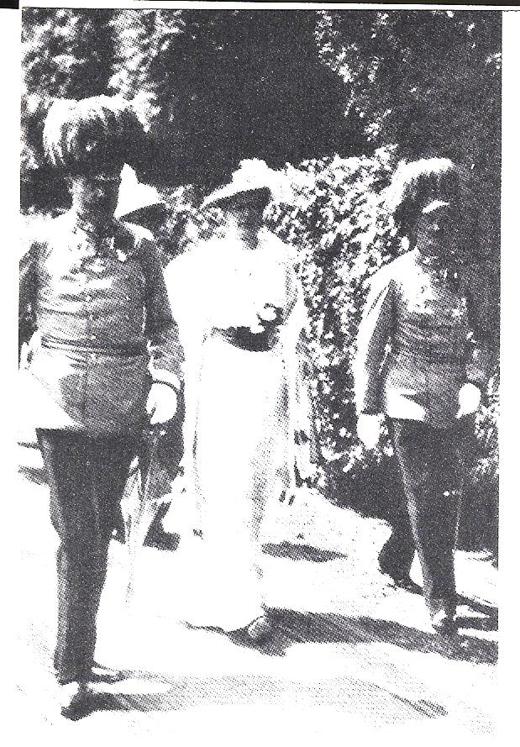
Archduke Franz Ferdinand, the Duchess and General Potiorek June 28 1914
Archduke
Franz Ferdinand
Gavrilo Princip
Assassin
Archduke,
Duchess
King Alexander, Queen Draga
Obrenović
King Petar
Karadjordjević
Dragutin Dimitriević
‘Apis'
Head of Black Hand
Nikola Pašić
Prime Minister
Nedeljko
Čabrinović
Assassin
Trifko Grabež
Assassin
Danilo Ilić
Assassin

Slide 18
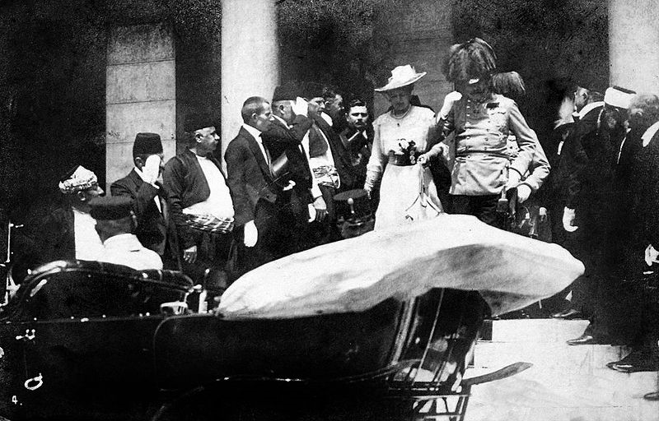
The Archduke and the Duchess leave the Town Hall in Sarajevo 28 June 1914
Archduke
Franz Ferdinand
Gavrilo Princip
Assassin
Archduke,
Duchess
King Alexander, Queen Draga
Obrenović
King Petar
Karadjordjević
Dragutin Dimitriević
‘Apis'
Head of Black Hand
Nikola Pašić
Prime Minister
Nedeljko
Čabrinović
Assassin
Trifko Grabež
Assassin
Danilo Ilić
Assassin

Slide 19
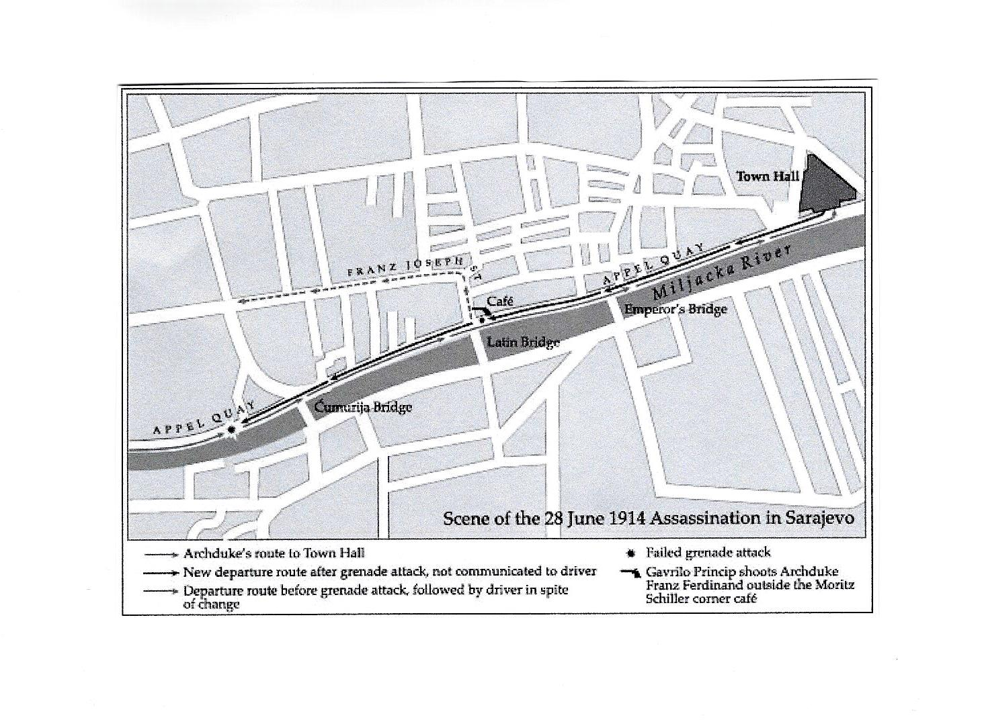
Archduke
Franz Ferdinand
Gavrilo Princip
Assassin
Archduke,
Duchess
King Alexander, Queen Draga
Obrenović
King Petar
Karadjordjević
Dragutin Dimitriević
‘Apis'
Head of Black Hand
Nikola Pašić
Prime Minister
Nedeljko
Čabrinović
Assassin
Trifko Grabež
Assassin
Danilo Ilić
Assassin

Slide 20
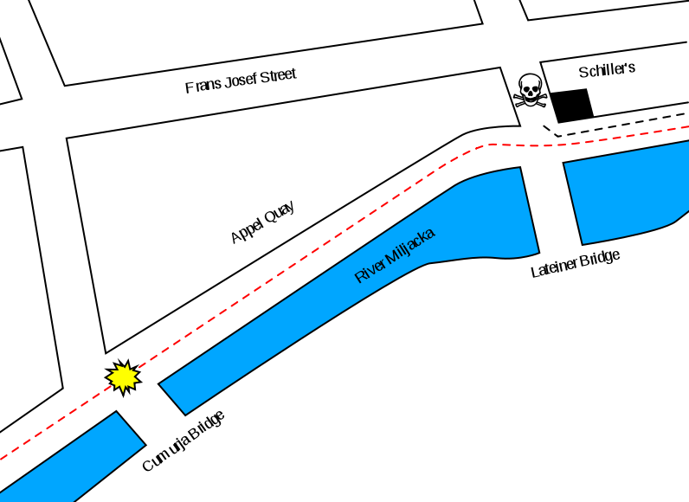
Archduke
Franz Ferdinand
Gavrilo Princip
Assassin
Archduke,
Duchess
King Alexander, Queen Draga
Obrenović
King Petar
Karadjordjević
Dragutin Dimitriević
‘Apis'
Head of Black Hand
Nikola Pašić
Prime Minister
Nedeljko
Čabrinović
Assassin
Trifko Grabež
Assassin
Danilo Ilić
Assassin

Slide 21
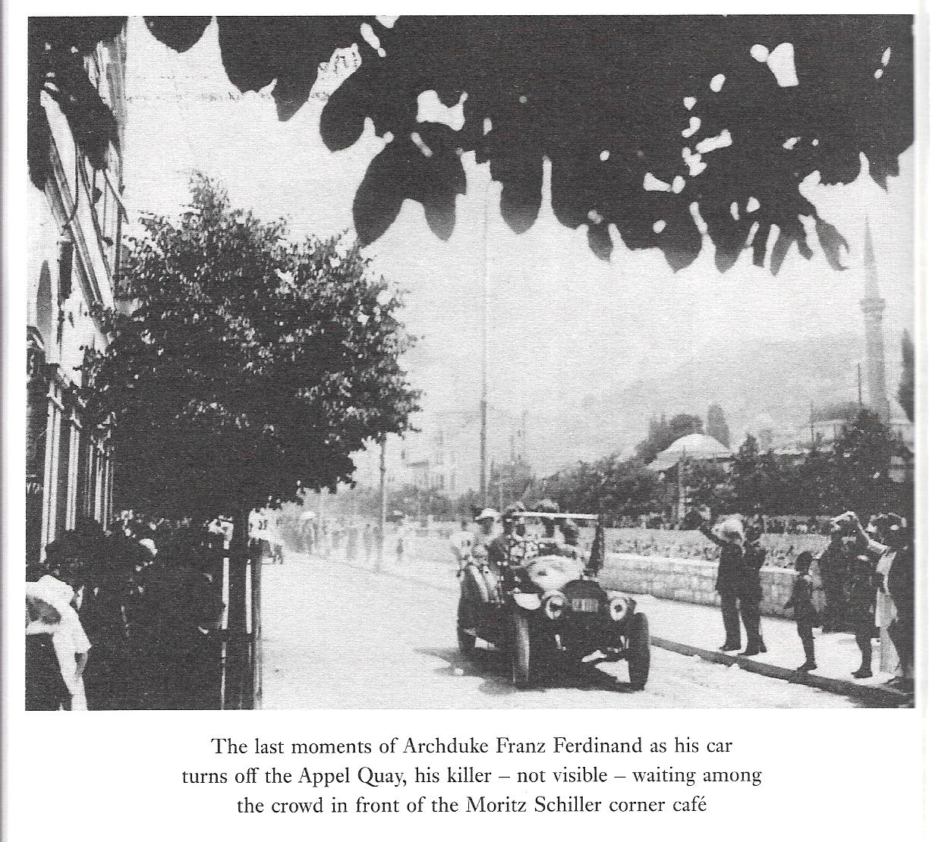
Archduke
Franz Ferdinand
Gavrilo Princip
Assassin
Archduke,
Duchess
King Alexander, Queen Draga
Obrenović
King Petar
Karadjordjević
Dragutin Dimitriević
‘Apis'
Head of Black Hand
Nikola Pašić
Prime Minister
Nedeljko
Čabrinović
Assassin
Trifko Grabež
Assassin
Danilo Ilić
Assassin

Slide 22
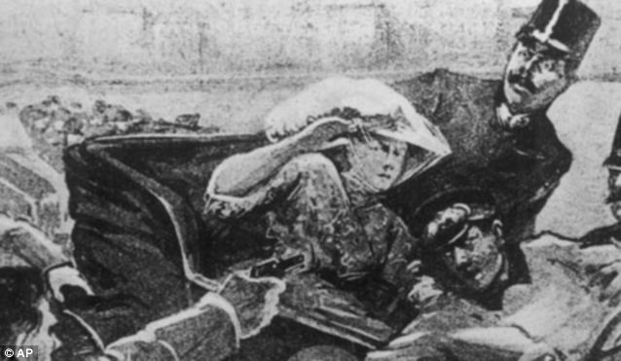
Artist’s Impression of the Moment of Assassination, 28 June 1914
Archduke
Franz Ferdinand
Gavrilo Princip
Assassin
Archduke,
Duchess
King Alexander, Queen Draga
Obrenović
King Petar
Karadjordjević
Dragutin Dimitriević
‘Apis'
Head of Black Hand
Nikola Pašić
Prime Minister
Nedeljko
Čabrinović
Assassin
Trifko Grabež
Assassin
Danilo Ilić
Assassin

Slide 23
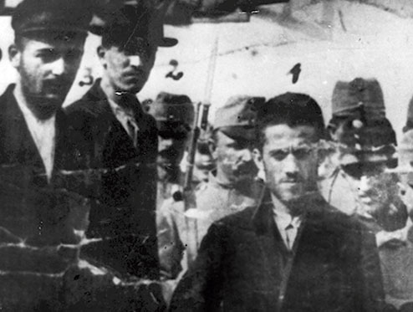
Čabrinović, Ilić and Princip on their way to the Courtroom
Archduke
Franz Ferdinand
Gavrilo Princip
Assassin
Archduke,
Duchess
King Alexander, Queen Draga
Obrenović
King Petar
Karadjordjević
Dragutin Dimitriević
‘Apis'
Head of Black Hand
Nikola Pašić
Prime Minister
Nedeljko
Čabrinović
Assassin
Trifko Grabež
Assassin
Danilo Ilić
Assassin

Slide 24
The Trial. Front Row: Grabež, Čabrinović, Princip, Ilić, Čubrilović
Archduke
Franz Ferdinand
Gavrilo Princip
Assassin
Archduke,
Duchess
King Alexander, Queen Draga
Obrenović
King Petar
Karadjordjević
Dragutin Dimitriević
‘Apis'
Head of Black Hand
Nikola Pašić
Prime Minister
Nedeljko
Čabrinović
Assassin
Trifko Grabež
Assassin
Danilo Ilić
Assassin

Slide 25
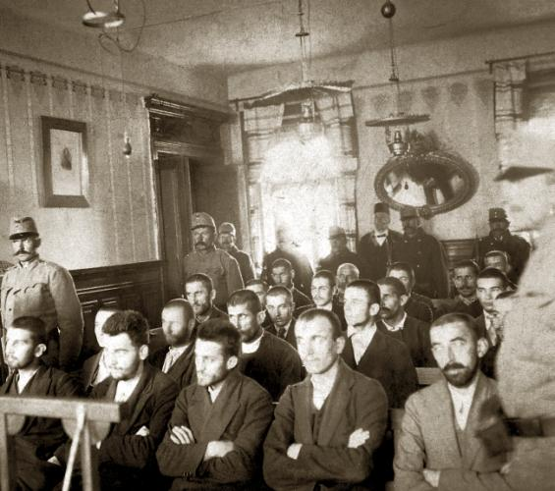
Archduke
Franz Ferdinand
Gavrilo Princip
Assassin
Archduke,
Duchess
King Alexander, Queen Draga
Obrenović
King Petar
Karadjordjević
Dragutin Dimitriević
‘Apis'
Head of Black Hand
Nikola Pašić
Prime Minister
Nedeljko
Čabrinović
Assassin
Trifko Grabež
Assassin
Danilo Ilić
Assassin

Slide 26
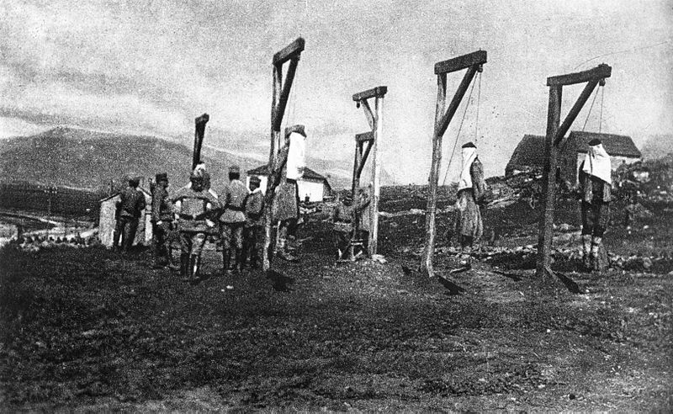
Serbs hanged in Trebinje as a reprisal for the assassination
Archduke
Franz Ferdinand
Gavrilo Princip
Assassin
Archduke,
Duchess
King Alexander, Queen Draga
Obrenović
King Petar
Karadjordjević
Dragutin Dimitriević
‘Apis'
Head of Black Hand
Nikola Pašić
Prime Minister
Nedeljko
Čabrinović
Assassin
Trifko Grabež
Assassin
Danilo Ilić
Assassin

Slide 27
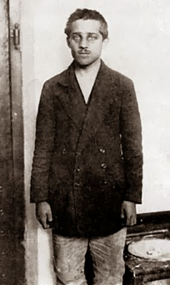
Gavrilo Princip
Archduke
Franz Ferdinand
Gavrilo Princip
Assassin
Archduke,
Duchess
King Alexander, Queen Draga
Obrenović
King Petar
Karadjordjević
Dragutin Dimitriević
‘Apis'
Head of Black Hand
Nikola Pašić
Prime Minister
Nedeljko
Čabrinović
Assassin
Trifko Grabež
Assassin
Danilo Ilić
Assassin

