Slide 1
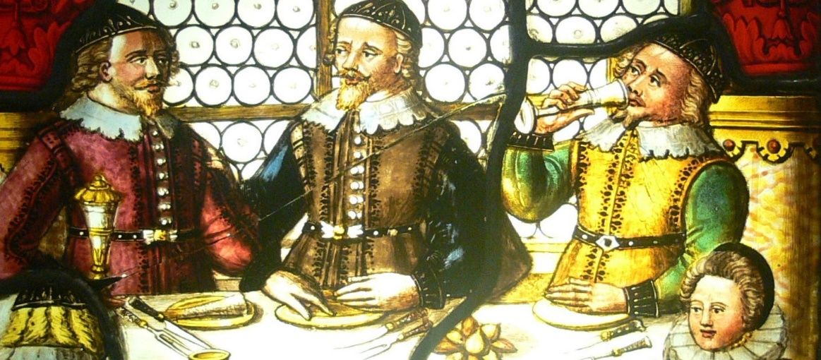
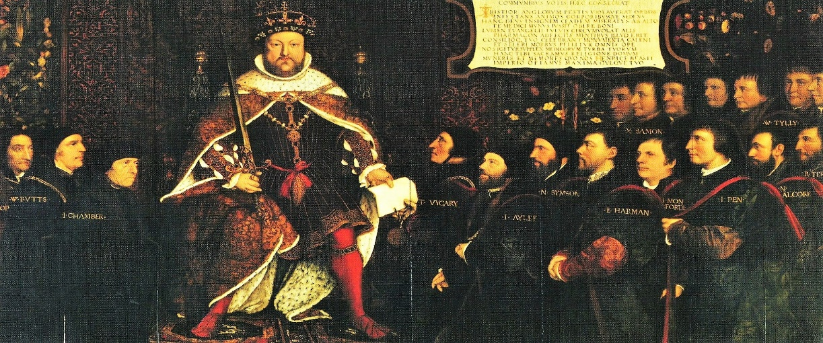
How Do Bad Institutions Survive?
Lessons from European History
Figuerola Lecture
Madrid, 14 December 2016
Sheilagh Ogilvie
Faculty of Economics, University of Cambridge

Slide 2
Why is this important?
institutions = “the rules of the game in a society ... the humanly devised constraints that shape human interaction” (North 1990)
many economists have argued that institutions are efficient solutions to economic problems
but many economies seem to suffer from bad institutions
address this puzzle using a particular historical institution: guild
guilds dominated European industry & trade from 11th to 19th c.
harmed the poor & imposed deadweight costs on whole economy
but survived for 800 years - economic reasoning can explain why ...

Slide 3
A brief history of guilds
guild = association of people who share certain interests and wish to pursue common purposes
most guilds were occupation-based & pursued economic purposes
guilds existed across Europe for over 8 centuries (c.1000- c.1880)
but after c. 1500, guilds weakened in Low Countries & England, strengthened in Germany, Switzerland, Austria, Bohemia, Hungary, Poland, Scandinavia, Italy, Spain, Portugal ...
any theory of institutions has to explain this variation in strength of guilds across different European societies

Slide 4
What did guilds do?
a guild had legal privileges giving its members exclusive right to practise particular occupation in particular place:
  monopoly over producing specific goods & services
  monopsony over purchasing & using specific inputs
in order to enforce its monopoly & monopsony privileges, a guild:
  limited entry
  restricted quantity of goods/services produced
  set output prices above competitive level
  set input costs (esp. wages) below competitive level

Slide 5
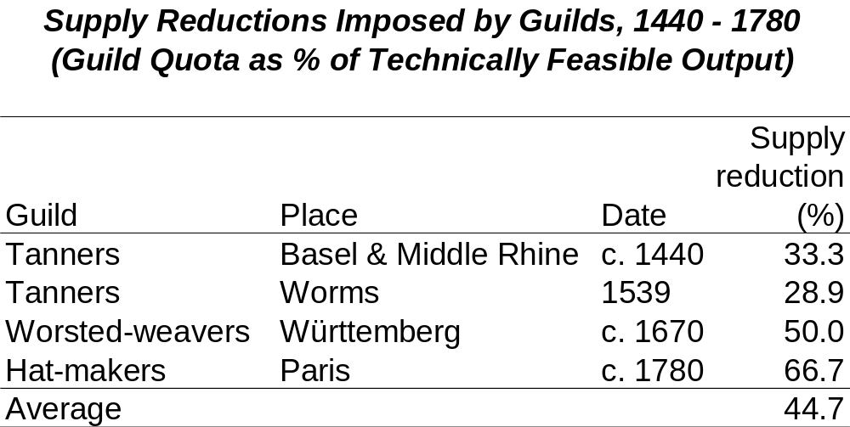

Slide 6
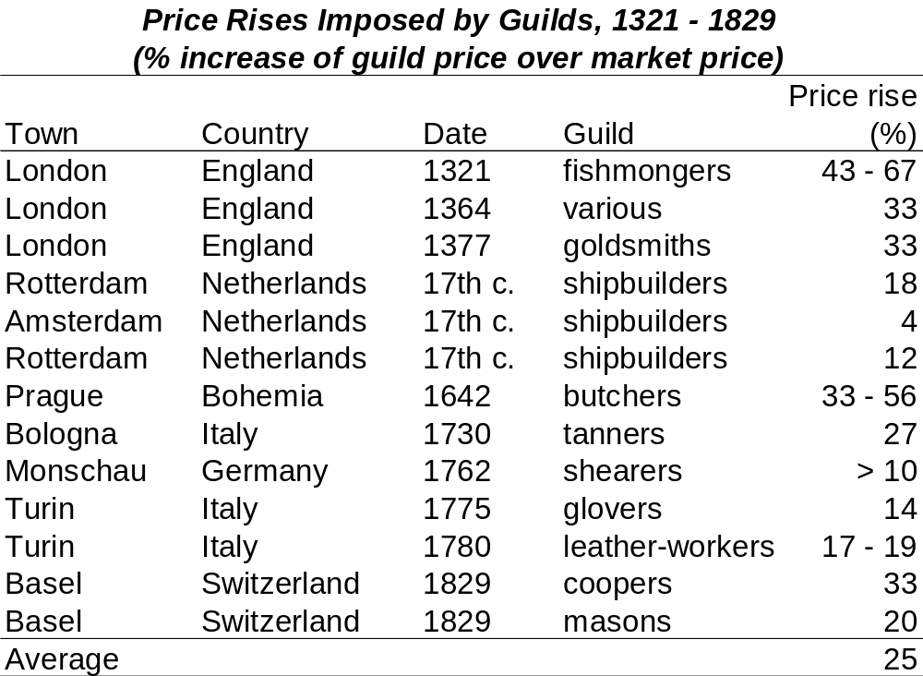

Slide 7
But maybe guilds were “efficient” because they guaranteed quality & protected consumers?
guilds often set minimum standards & prohibited low-quality goods
in some cases, this protected consumers, but in others, it harmed consumers by banning nasty-but-cheap goods
it also harmed industries by making them high-cost & inflexible:
  It is not the careful making of a few stockings, but the general making of many, that is best for the public good, for that sets more people on work ... and when the stockings are made, there are amongst them some for all sorts of people, and the buyer is able to judge of them and to give prices accordingly. If none but fine stockings be made, the poor must go without. (petition against the guilded stocking-knitters, Leicester, 1673)
many successful European industries had no guild quality controls

Slide 8
Were guilds “efficient” because they fostered human capital investment?
many guilds required apprenticeship ... but then restricted access to it, excluding girls, Jews, bastards, paupers, non-masters’-sons, ...
many other guilds didn’t even require apprenticeship
  40% of Italian guilds had no apprenticehip requirement
  many Paris guilds admitted >50% of masters without apprenticeship
non-guild apprenticeships were widespread (England, Netherlands)
non-apprenticed “interlopers” (women, Jews) produced well & attracted consumers (which was why guilds saw them as a threat)
many entire industries without guild apprenticeship rules flourished

Slide 9
Were guilds “efficient” because their monopoly profits motivated innovators?
some economic models theorize that monopoly profits provide the incentives to make producers innovate
but all these models require free entry – so can’t apply to guilds
instead, guilds believed innovations destroyed members’ jobs:
    If a shoemaker comes along with new tools and makes 70 shoes in a day, where others make 20, that would be ruin of 100 or 200 shoemakers. (Eiximenis, Catalan philosopher, 14th century)
they didn’t realise that innovation also increases buying power
so they lobbied against innovations, forbade members to use them, boycotted wares & workers from places that adopted inventions

Slide 10
So ... guilds provide little support for “efficiency” theory of institutions
limited entry & prevented outsiders (women, migrants, Jews, bastards, gypsies, Moors, Slavs, serfs, ...) from earning a living
enabled businessmen to limit supply & charge artificially high prices
enabled employers to depress wages
let producers impose higher quality/cost than consumers wanted
limited access to apprenticeship => reduced human capital
allowed established businesses to block disruptive technologies
made economic pie smaller for everyone
harmed consumers, workers, weaker members of society

Slide 11
How could such harmful institutions survive so long in so many places?
guilds offered benefits to businessmen & political elites
enabled these two groups to cooperate to capture more resources for themselves at the expense of the rest of the economy
a guild provided mechanism for group of businessmen to negotiate with political elites for privileges giving them monopoly profits
businessmen then used guild to redirect a share of these profits to political elites in return for support and enforcement
neither businessmen nor political elites could have extracted these profits on their own – guilds provided an organizational device

Slide 12
Every successful guild had a government “ordinance” guaranteeing its monopoly
as soon as guilds emerged, they asked towns and rulers for “ordinances” giving them the right to limit entry & enforce monopoly
without government ordinance, guild couldn’t enforce its privileges
  Paris 1268: barber-surgeons can’t limit entry without royal ordinance
  York c. 1460: guilds can’t enforce their rules without town ordinance
  Palermo 1612: tailors’ guild rules are invalid without town approval
  Madrid 1660: cabinetmakers’ guild claims that the carpenters are not really carpenters at all, because they are “without ordinances”
European towns & rulers issued huge numbers of guild ordinances every year from 1100 to 1883 ... see table ...

Slide 13
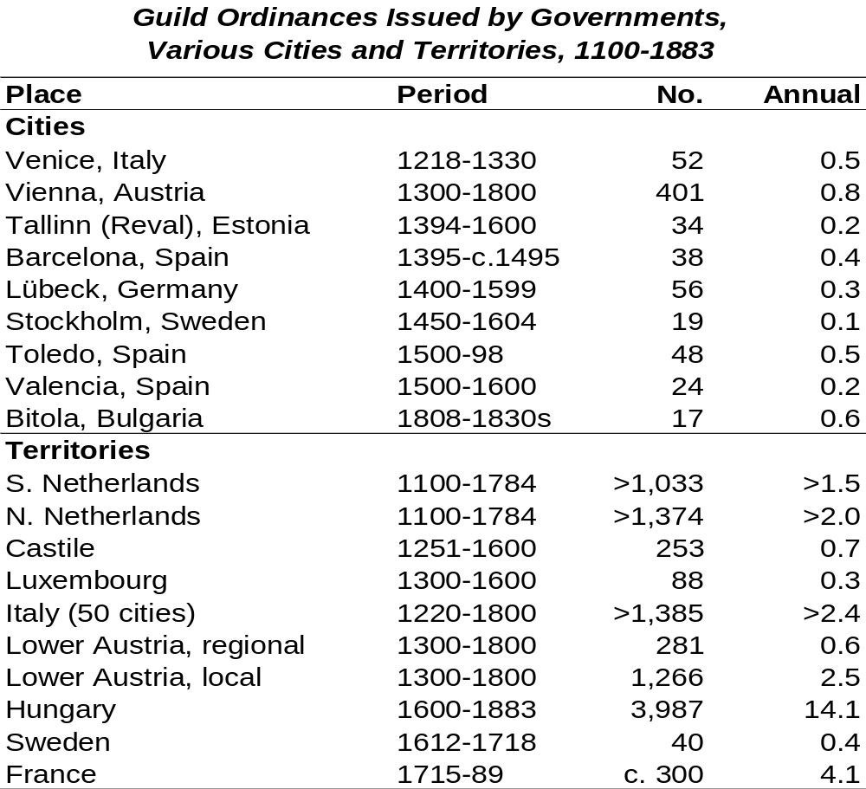

Slide 14
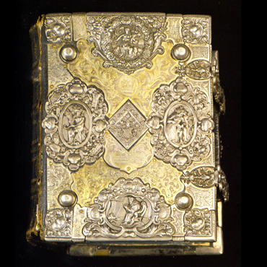

Slide 15
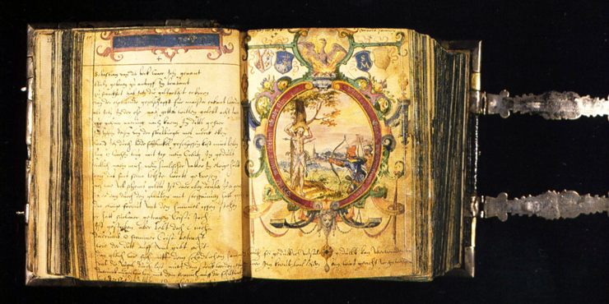

Slide 16
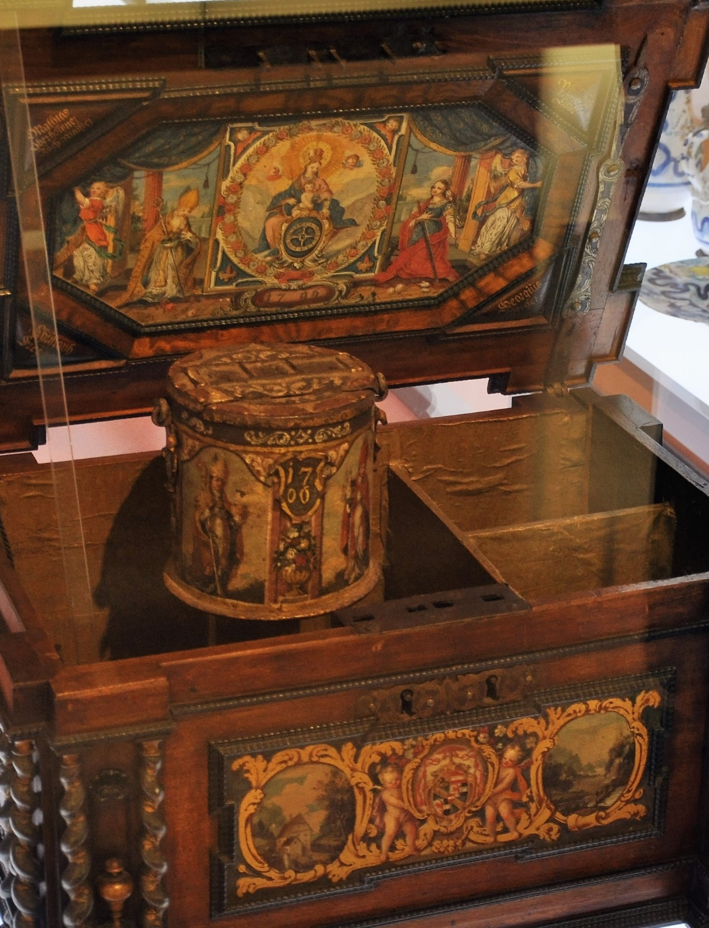

Slide 17
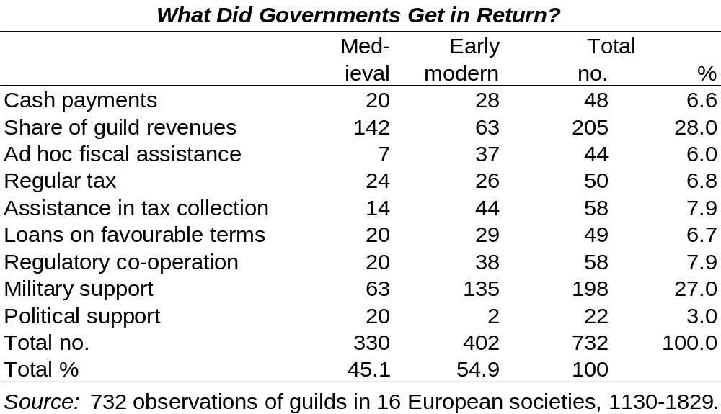

Slide 18
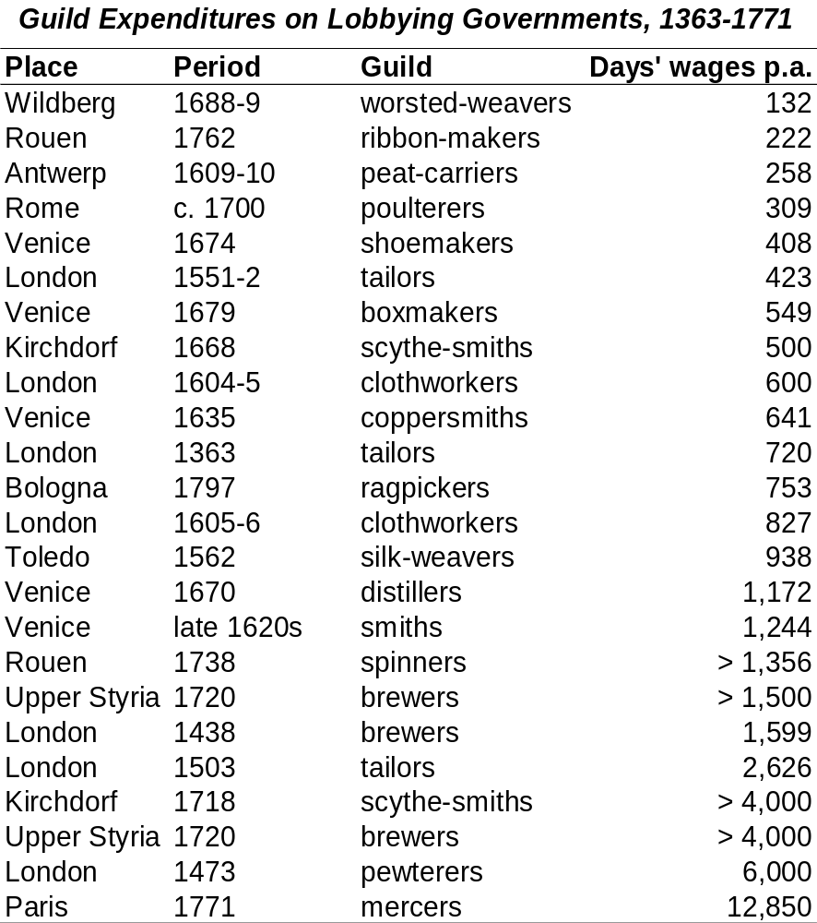

Slide 19
The deal was explicit
1154: London weavers’ guild gets ordinance from king: “provided always that for this privilege they pay me 2 gold marks each year”
1386: Perpignan drapers’ guild gets a new ordinance restoring its monopoly & privileges, for which it pays 1,000 gold florins to King Peter III
1612: Venice canvas-makers’ guild gets new monopoly because “the public mind wishes to give each guild the fitting burden of military & other taxes, in accordance with the benefits and advantages conferred upon it”
1736: Calw merchant-dyers’ guild “is a substantial national treasure, especially during the recent French invasion and levy of military taxes, when it became apparent that no opportunity should be lost to give it a helping hand in all just matters as much as possible”

Slide 20
In northwest Europe, guilds gradually got weaker after c. 1500 – 5 key political characteristics
1. parliaments constrained how rulers could raise revenues & grant privileges to special-interest groups (but not all parliaments did this)
2. taxation became socially generalized (e.g. included nobles) => reduced state’s fiscal need to sell privileges to rent-seeking groups
3. government allowed financial market to develop, used it for public borrowing => also reduced fiscal attractiveness of selling privileges
4. towns competed => limited each other’s privileges
5. political framework included politically & economically powerful individuals involved in industry & trade who wanted to be free of guilds

Slide 21
What can we learn from guilds about theories of institutions?
guilds prevented outsiders from earning a living or getting training, and enabled businessmen to limit supply, over-charge consumers, keep workers’ wages low, and block disruptive technologies
    economic efficiency cannot explain why guilds survived
guilds benefited entrenched businessmen and political elites, who openly collaborated to establish and enforce guild privileges:
    distributional conflicts can explain why guilds survived
    outcome of these economic conflicts depended on the political system

Slide 22
Policy lessons
entrenched producers can secure entry barriers & market power by offering favours to political authorities – also happens nowadays
governments grant such privileges in return for a share of the profits generated by the market power the privileges make possible
rent-seeking groups often claim that quality standards, training requirements & “high-tech” status justify legal monopolies
total costs of such institutions are high but spread over whole economy; total benefits are low but concentrated in small groups
the way they distribute benefits & costs makes it difficult to reform such institutions – but entire economy can benefit from doing so

