Slide 1

Do We Need Prudence in IFRS?
Alfred Wagenhofer
University of Graz

Slide 2

Agenda
Background
  IFRS Framework development
  EU views
Analysis
  Finance theory paradigm
  Accounting anomalies
  Market efficiency
Academic research
  Theoretical research
  Empirical research
Conclusions and way forward

Slide 3
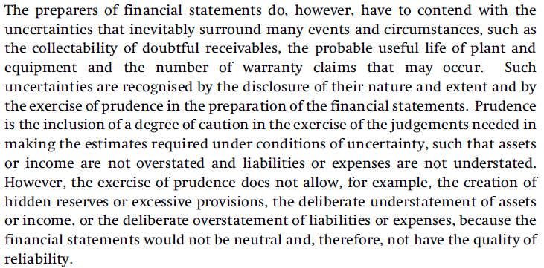
Background:
The old IAS Framework (1989)
Definition of prudence (para. 37)

Slide 4
Background:
IFRS Conceptual Framework (2010)
Joint project with the FASB
Eliminates prudence
  “… does not include prudence or conservatism as an aspect of faithful representation because including either would be inconsistent with neutrality” (BC3.27)
  Little discussion of merits or disadvantages
IFRS Conceptual Framework Discussion Paper (2013)
  No change proposed
  Does not want to reopen the debate about principles

Slide 5
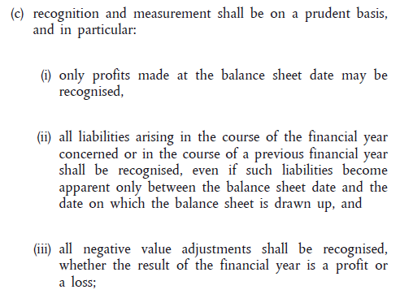
Background:
EU accounting practice
Prudence has long history as an accounting principle
Accounting Directive reflects prudence in the
General financial reporting principles (Article 6)

Slide 6
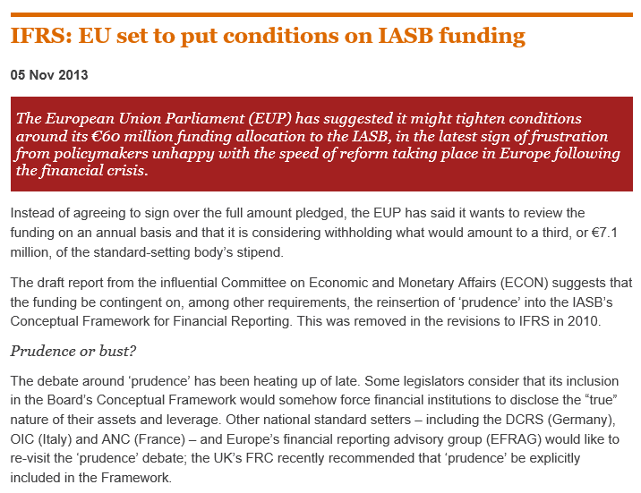
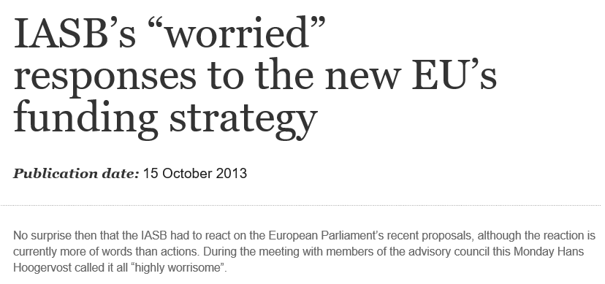
Background:
It even became political …
Main arguments
  Not abolish fundamental principle of financial reporting in the EU
  Many think fair value accounting contributed to the crisis
  IASB followed the U.S. with eliminating prudence,
  but with the end of convergence it should not any further

Slide 7
Current state:
IFRS Conceptual Framework ED (2015)
(Re-)Introduces prudence (Para. 2.18)
  Neutrality is supported by the exercise of prudence. Prudence is the exercise of caution when making judgements under conditions of uncertainty. The exercise of prudence means that assets and income are not overstated and liabilities and expenses are not understated. Equally, the exercise of prudence does not allow for the understatement of assets and income or the overstatement of liabilities and expenses, because such mis-statements can lead to the overstatement of income or the understatement of expenses in future periods.
Develops distinction between
  “Cautious prudence” (“good” prudence) and
  “Asymmetric prudence” (“bad” prudence)

Slide 8
Current state:
IFRS Conceptual Framework ED (2015)
Explains in the Basis for Conclusions that
cautious prudence helps achieve neutrality
  ED arguments for cautious prudence
    Counter a natural optimistic bias of management
    Help IASB to develop standards that counteract any management bias
  ED notes that cautious prudence does not …
    require recognition of all assets and liabilities
    require value of entity on balance sheet
    require measurement of all items at current value
    prohibit impairment tests under historical cost measurement

Slide 9
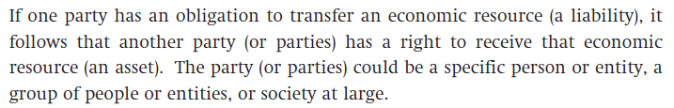
Analysis
The view that cautious prudence helps achieve neutrality is an interesting proposition!
Consider neutrality or bias of
  Historical cost measurement and impairment
  Recognition of revenue at transfer of control, but onerous contracts
Does neutrality imply symmetric recognition and measurement of assets and liabilities?
  Abolishment of probability threshold in definition of assets and liabilities and in recognition criteria (as suggested in ED)
  Contingent assets vs contingent liabilities
  Symmetry across firms (ED 4.25) – consider lawsuits …

Slide 10
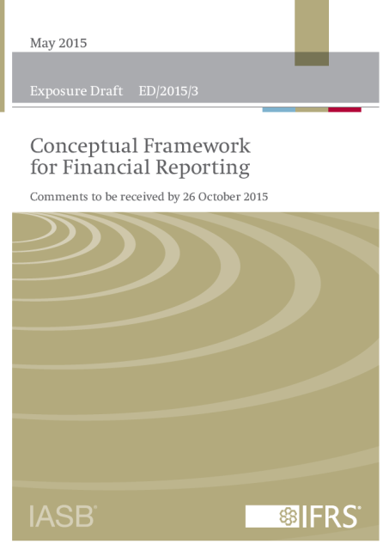
Feedback from constituents to ED Conceptual Framework (March 2016)
233 comment letters
75% of respondents commented on prudence
Views
  Much support for reintroduction of prudence
  (particularly from Europe)
  Some support for introducing asymmetric
  prudence rather than cautious prudence
  Many different detailed suggestions
  Against prudence: some respondents,
  mainly from Australia and New Zealand
EFRAG comment letter
  Strongly opposes ED proposal

Slide 11
The trigger:
Rise of financial instruments
Enormous development of financial markets
  Financial engineering creates novel financial instruments
  Improves risk allocation
  Transformation of operative cash flows into cash flows with different characteristics: Hedging and speculation
  Creates new concerns. Example: Asset-backed securities eliminate the monitoring function of creditor who knows originator
We already have special accounting principles for financial instruments
  Recognition: No probability threshold
  Measurement: Basically fair value
    Avoids earnings management: To recognize holding gain,
    no need to sell asset
  Symmetric measurement avoids accounting mismatch

Slide 12
Paradigm shift:
Prevalence of finance theory
Finance theory as basis for consistent framework
for development of accounting methods
  Efficient markets and availability of market prices
  Basis for fair values (no-arbitrage condition, DCF)
  Simple, elegant theories (CAPM, irrelevance of capital structure)
    Interesting aside: Risk premium induces asymmetry in measurement of assets and liabilities
Requires valuation expert knowledge
  Many preparers unable to apply measurement rules without assistance from outside experts
  Determining interest rates, risk premiums, correlations
  But still room for discretion
  Think of choice of outliers, periods, markets, peers, …

Slide 13
Finance theory and accounting anomalies:
Own credit risk
Determining fair value of derivatives (IFRS 13)
  CVA Credit Value Adjustment
  DVA Debit Value Adjustment (= for own credit risk)
Why an increase in own credit risk leads to a gain?
  Finance theory explanation for “anomaly”
  Even under fair value measurement, a gain still arises because
  not all assets are recognized
Assets
Equity
Assets
Equity
Consequential reduction of equity and liabilities
Liabilities
Liabilities
Loss in value

Slide 14
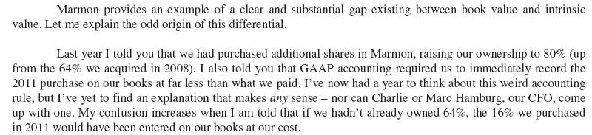
Finance theory and accounting anomalies: Step acquisitions
Acquisition of additional shares in a subsidiary
  Is an exchange of non-controlling interest and parent interest
Example: Berkshire 2012:
Warren Buffett’s shareholder letter
However, only measuring all equity at fair value would avoid such an anomaly

Slide 15
Belief in market efficiency
Fair values work well in efficient markets
But: In fully efficient markets no need for accounting
Existence of market anomalies suggests frictions
Issue arises in several research studies
  Value relevance research assumes that prices are efficient, and evaluates accounting based on how well it fits market prices
  Basu measure of conservatism uses
  market price as benchmark to show
  that accounting earnings behave
  asymmetrically
  This reverses the idea that
  accounting should inform
  market participants and pricing
  But is in line with confirmatory role
Earnings
Conservatism
Market price change

Slide 16
Not covered by finance theory paradigm
Operating activities (the “real” economy)
  Firms engage in acquiring inputs and, using their individual competencies, produce products and services
  Firms create value using proprietary knowledge and skills
  Combinations of financial instruments do not increase cash flows, they just affect their joint risk (diversification)
Stewardship objective
  Capital market information view ignores contracting
    Although shares are very specific, standardized contracts
  No consideration of real effects of accounting information
  IASB suggests stewardship should be dealt in individual contracts and parties are free to define the optimal accounting for the specific situation they face

Slide 17
Illustration:
Development of revenue recognition standard
Early idea of IASB and FASB: Forcing finance theory paradigm on revenue recognition
  Asset-liability approach (performance obligation and claim on consideration) and fair value measurement
  Consequences
    If contract is calculated with profit margin, expected profit is recognised at contract inception (day-1 profit)
    Subsequent execution yields zero expected profit
    Fair value includes expected, but not delivered performance
Eventually, IASB and FASB dismissed approach
    Reasoning: “[we] are uncomfortable with an approach that allows an entity to recognise revenue before the entity transfers to the customer any of the goods and services that are promised in the contract” (DP 2008)

Slide 18
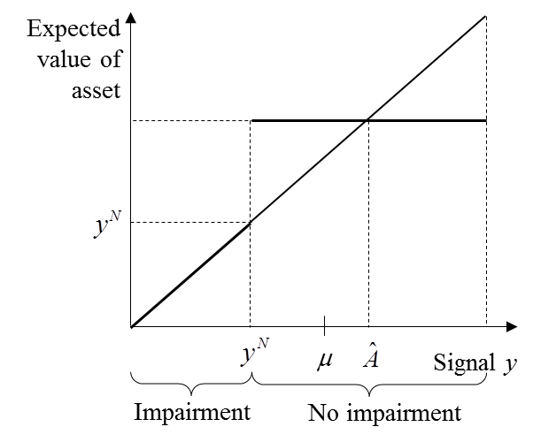
Academic research:
Conceptualizing prudence/conservatism
Tendency to understate earnings
  In binary setting: increase
  α-error (relative to β-error)
  Effects
    Increases prob(y_{L})
    Makes high earnings
    more precise
Early disclosure of bad news
  Disclose low earnings, but not high
  earnings (pools earnings above
  threshold)
  Effect: Makes low earnings more
  precise
1 – β
Outcome x_{L}
Earnings y_{L}
β
α
Outcome x_{H}
Earnings y_{H}
1 – α

Slide 19
Academic research:
Decision-usefulness models
What information benefits risk averse investors more? (Armstrong et al. 2016)
  CAPM context
  Firm chooses costly precision of earnings report
  Result: Firms with lower profitability (earnings mean) invest
  more in precision (is consistent with conservatism)
  Reason: Information is more valuable at the lower end
  (owner is relative “more risk averse” for low earnings)
Experimental evidence on asset and liability definition (Cade/Ikuta-Mendoza/Koonce 2016)
  Show that individuals think about existence of assets in a fundamentally different way than of liabilities
  Individuals appear to employ higher probability threshold for assets

Slide 20
Academic research:
Financial contracting models
Impairment in debt financing (Göx/Wagenhofer 2009)
  Value of assets as collateral determines whether lender provides
  loan to invest in positive-NPV project
  Measurement at cost with impairment is optimal because it maximizes likelihood of obtaining loan
Aggressive reporting in debt covenant (Gigler et al. 2009)
  Covenant allocates decision rights to abandon investment
  After investment, firm always wants to continue project;
  lender tends to abandonment to receive proceeds from selling
  α-error: Abandon project although continuation maximizes welfare
  β-error: Continue project although abandonment maximizes welfare
  Aggressive accounting is optimal because it minimizes α-error, which is more costly because project has ex ante positive NPV

Slide 21
Academic research:
Management incentives models
Share price of firm as performance measure (Shin 2007)
  Management compensation based on market price
  Market anticipates future efforts and prices firm correctly
  To manager, market price becomes independent of actual effort because it is based on anticipated effort (which is “fixed”)
    In the extreme: No incentives to work hard!
  Market equilibrium (rational expectations): Market anticipates no effort, and manager delivers no effort
Conservatism and earnings management
  More conservatism can reduce earnings management because it makes overstated earnings less likely
  More conservatism can increase earnings management because aggressive reporting gives no more room for overstating earnings

Slide 22
Academic research:
Empirical findings
Distinguishes
  Unconditional conservatism (“bad” conservatism)
  Conditional conservatism (“good” conservatism)
  “Good” qualification is interesting because
    unclear why favorable information should not be reported timely
    it is harder to overcome unconditional conservatism through earnings management
Common proxies
  Market-to-book ratio
  Basu measure of differential timeliness
Studies show that conservative accounting is prevalent
  Most studies show associations
  Few also consider causality

Slide 23
Academic research: Empirical findings
(summarized in Mora/Walker 2015)
Conservatism varies across countries
  Highlights institutional context, eg capital market development, investor protection, legal system, enforcement, litigation, tax
Conservatism varies across individual firms
  Highlights corporate governance, ownership concentration
Conservatism and debt contracts
  Substitutes for lender monitoring and decreases cost of debt
Conservatism and earnings management
  Conservatism can increase or reduce accrual earnings management
Conservatism and information in markets
  Conservatism can increase or decrease predictive value of financial reports and can reduce information asymmetry

Slide 24
Take-aways from academic literature
Both theoretical and empirical research provide inconclusive findings on prudence (conservatism)
  Desirability of prudence varies with decision-usefulness or stewardship use of financial reporting
  Desirability of prudence is context-specific
Even if we find prevalence of prudence, we know little about the exact mechanisms that lead to that
  Proponents: Prudence is a market outcome
  Opponents: Accounting standards are bad and should be reformed
General insight: neutral accounting is almost never optimal and is as arbitrary as a particular level of conservatism

Slide 25
Take-aways from academic literature
Difficult situation for standard setter
  Apparently favors neutral accounting because of inconclusive research resuls
  Neutral accounting in line with a priori thinking: Who wants biased information if it is possible to receive unbiased information?
View is reminiscent of desire to discover “true” accounting 100 years ago
(although now applying finance theory)
  Ignores that value of information depends on the purpose
  Ignores real effects of accounting (and value creation by firms)
  Ignores context: incentives, legal system, …

Slide 26
Fundamental issue:
How to deal with uncertainty
Usefulness of information implies underlying uncertainty
Some issues addressed in IFRS
  Best estimate: Arithmetic mean vs. most likely outcome
  Financial statement aggregate items with differing precision
  Some information in notes required on uncertainty
  (nature, risk of adjustment of amounts, assumptions, ranges of outcomes, sensitivity analysis)
Some issues not addressed in IFRS
  Incentives, such as “Take the money and run”: Capping compensation, protecting (non-contracting) claimants
  Boards and oversight bodies focus on (avoiding) downside risk
  Confirmatory role of accounting (relative to other information)
  Idea of non-reversability of profits (ASBJ proposal)

Slide 27
Conclusion:
So, do we need prudence?
(Not surprisingly) Yes.
What does that mean for the development of the
IFRS Conceptual Framework?
  Acknowledge that accounting is inherently conservative: it does not (attempt to) portray company value (eg growth options)
  Both neutrality and prudence are elements of faithful representation and require trade-off in setting standards
  Clarify that prudence addresses standard setter but not users
  (no “excuse” for users to manage earnings)
  Separate accounting principles for financial and operative (real) activities (business model)
  Give more weight to stewardship and confirmatory role
  Consider real effects and economic efficiency consequences

Slide 28
“You might very well ask what the heck was wrong with this [the previous Framework’s] definition of Prudence? My answer would be: absolutely nothing.”
Hans Hoogervoorst: The Concept of Prudence: Dead or Alive?, Speech at the FEE Conference on Corporate Reporting of the Future, Brussels, 18 September 2012

Slide 29
Thank you!

